Slide 1
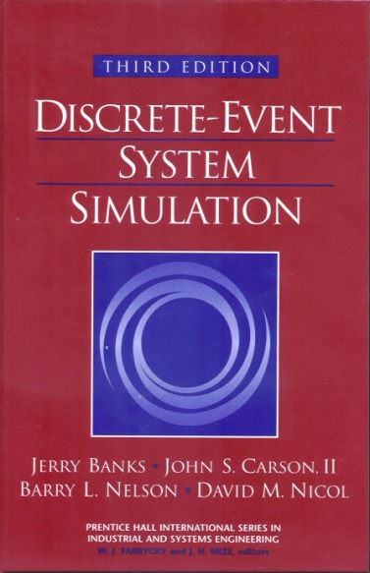
DISCRETE-EVENT SYSTEM SIMULATION
Third Edition
Jerry Banks • John S. Carson II
Barry L. Nelson • David M. Nicol

Slide 2
Part I. Introduction to Discrete-Event System Simulation
Ch.1 Introduction to Simulation
Ch.2 Simulation Examples
Ch.3 General Principles
Ch.4 Simulation Software

Slide 3
Ch. 1 Introduction to Simulation
Real-world process
A set of assumptions
Modeling & Analysis
concerning the behavior of a system
Simulation
the imitation of the operation of a real-world process or system over time
to develop a set of assumptions of mathematical, logical, and symbolic relationship between the entities of interest, of the system.
to estimate the measures of performance of the system with the simulation-generated data
Simulation modeling can be used
as an analysis tool for predicting the effect of changes to existing systems
as a design tool to predict the performance of new systems

Slide 4
1.1 When Simulation is the Appropriate Tool (1)
Simulation enables the study of, and experimentation with, the internal interactions of a complex system, or of a subsystem within a complex system.
Informational, organizational, and environmental changes can be simulated, and the effect of these alterations on the model’s behavior can be observed.
The knowledge gained in designing a simulation model may be of great value toward suggesting improvement in the system under investigation.
By changing simulation inputs and observing the resulting outputs, valuable insight may be obtained into which variables are most important and how variables interact.
Simulation can be used as a pedagogical device to reinforce analytic solution methodologies.

Slide 5
1.1 When Simulation is the Appropriate Tool (2)
Simulation can be used to experiment with new designs or policies prior to implementation, so as to prepare for what may happen.
Simulation can be used to verify analytic solutions.
By simulating different capabilities for a machine, requirements can be determined.
Simulation models designed for training allow learning without the cost and disruption of on-the-job learning.
Animation shows a system in simulated operation so that the plan can be visualized.
The modern system (factory, wafer fabrication plant, service organization, etc.) is so complex that the interactions can be treated only through simulation.

Slide 6
1.2 When Simulation is not Appropriate
When the problem can be solved using common sense.
When the problem can be solved analytically.
When it is easier to perform direct experiments.
When the simulation costs exceed the savings.
When the resources or time are not available.
When system behavior is too complex or can’t be defined.
When there isn’t the ability to verify and validate the model.

Slide 7
1.3 Advantages and Disadvantages of Simulation (1)
Advantages
New polices, operating procedures, decision rules, information flows, organizational procedures, and so on can be explored without disrupting ongoing operations of the real system.
New hardware designs, physical layouts, transportation systems, and so on, can be tested without committing resources for their acquisition.
Hypotheses about how or why certain phenomena occur can be tested for feasibility.
Insight can be obtained about the interaction of variables.
Insight can be obtained about the importance of variables to the performance of the system.
Bottleneck analysis can be performed indicating where work-in-process, information, materials, and so on are being excessively delayed.
A simulation study can help in understanding how the system operates rather than how individuals think the system operates.
“What-if” questions can be answered. This is particularly useful in the design of new system.

Slide 8
1.3 Advantages and Disadvantages of Simulation (2)
Disadvantages
Model building requires special training. It is an art that is learned over time and through experience. Furthermore, if two models are constructed by two competent individuals, they may have similarities, but it is highly unlikely that they will be the same.
Simulation results may be difficult to interpret. Since most simulation outputs are essentially random variables (they are usually based on random inputs), it may be hard to determine whether an observation is a result of system interrelationships or randomness.
Simulation modeling and analysis can be time consuming and expensive. Skimping on resources for modeling and analysis may result in a simulation model or analysis that is not sufficient for the task.
Simulation is used in some cases when an analytical solution is possible, or even preferable, as discussed in Section 1.2. This might be particularly true in the simulation of some waiting lines where closed-form queueing models are available.

Slide 9
1.4 Areas of Application (1)
WSC(Winter Simulation Conference) : http://www.wintersim.org
Manufacturing Applications
Analysis of electronics assembly operations
Design and evaluation of a selective assembly station for high-precision scroll compressor shells
Comparison of dispatching rules for semiconductor manufacturing using large-facility models
Evaluation of cluster tool throughput for thin-film head production
Determining optimal lot size for a semiconductor back-end factory
Optimization of cycle time and utilization in semiconductor test manufacturing
Analysis of storage and retrieval strategies in a warehouse
Investigation of dynamics in a service-oriented supply chain
Model for an Army chemical munitions disposal facility
Semiconductor Manufacturing
Comparison of dispatching rules using large-facility models
The corrupting influence of variability
A new lot-release rule for wafer fabs

Slide 10
1.4 Areas of Application (2)
Assessment of potential gains in productivity due to proactive reticle management
Comparison of a 200-mm and 300-mm X-ray lithography cell
Capacity planning with time constraints between operations
300-mm logistic system risk reduction
Construction Engineering
Construction of a dam embankment
Trenchless renewal of underground urban infrastructures
Activity scheduling in a dynamic, multiproject setting
Investigation of the structural steel erection process
Special-purpose template for utility tunnel construction
Military Application
Modeling leadership effects and recruit type in an Army recruiting station
Design and test of an intelligent controller for autonomous underwater vehicles
Modeling military requirements for nonwarfighting operations
Multitrajectory performance for varying scenario sizes
Using adaptive agent in U.S Air Force pilot retention

Slide 11
1.4 Areas of Application (3)
Logistics, Transportation, and Distribution Applications
Evaluating the potential benefits of a rail-traffic planning algorithm
Evaluating strategies to improve railroad performance
Parametric modeling in rail-capacity planning
Analysis of passenger flows in an airport terminal
Proactive flight-schedule evaluation
Logistics issues in autonomous food production systems for extended-duration space exploration
Sizing industrial rail-car fleets
Product distribution in the newspaper industry
Design of a toll plaza
Choosing between rental-car locations
Quick-response replenishment

Slide 12
1.4 Areas of Application (4)
Business Process Simulation
Impact of connection bank redesign on airport gate assignment
Product development program planning
Reconciliation of business and systems modeling
Personnel forecasting and strategic workforce planning
Human Systems
Modeling human performance in complex systems
Studying the human element in air traffic control

Slide 13
1.5 Systems and System Environment
System
defined as a group of objects that are joined together in some regular interaction or interdependence toward the accomplishment of some purpose.
System Environment
changes occurring outside the system.
The decision on the boundary between the system and its environment may depend on the purpose of the study.

Slide 14
1.6 Components of a System (1)
Entity : an object of interest in the system.
Attribute : a property of an entity.
Activity : a time period of specified length.
State : the collection of variables necessary to describe the
system at any time, relative to the objectives of the
study.
Event : an instantaneous occurrence that may change the
state of the system.
Endogenous : to describe activities and events occurring
within a system.
Exogenous : to describe activities and events in an
environment that affect the system.

Slide 15
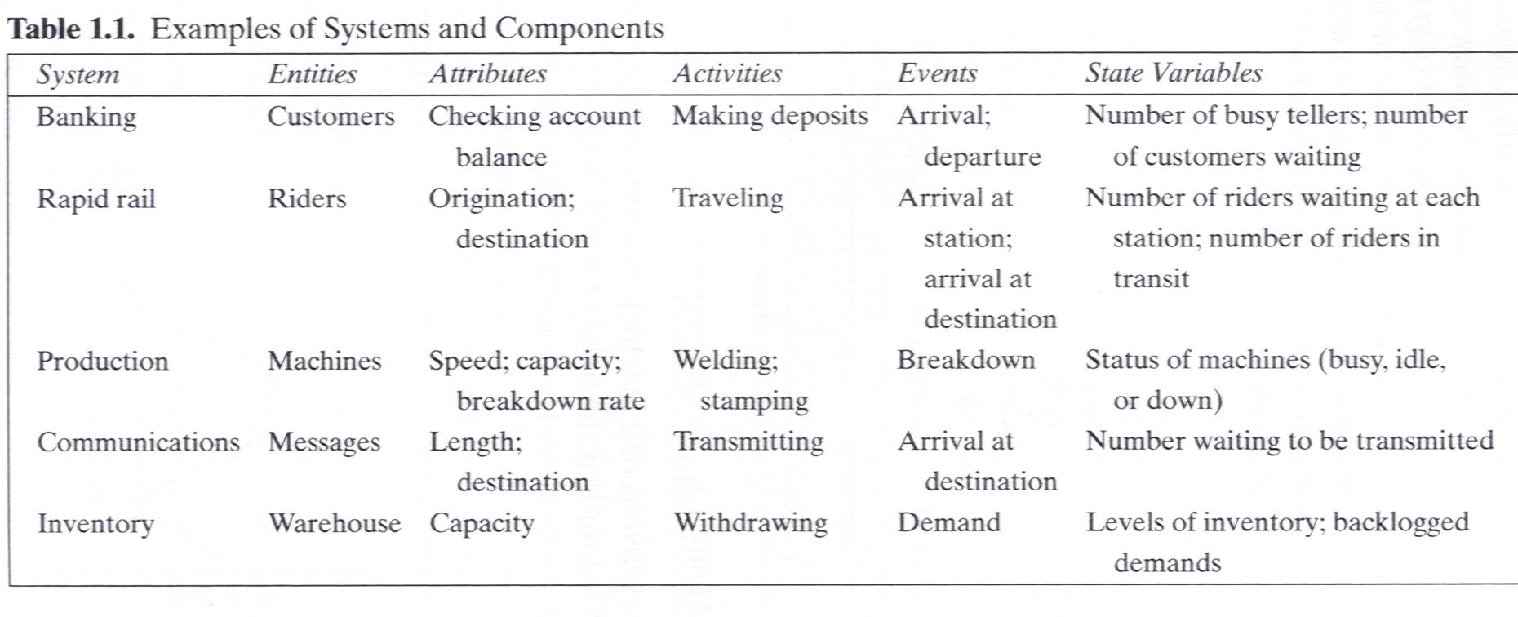
1.6 Components of a System (2)

Slide 16
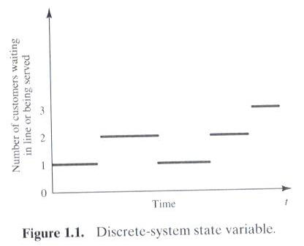
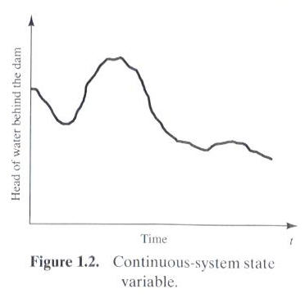
1.7 Discrete and Continuous Systems
Systems can be categorized as discrete or continuous.
Bank : a discrete system
The head of water behind a dam : a continuous system

Slide 17
1.8 Model of a System
Model
a representation of a system for the purpose of studying the system
a simplification of the system
sufficiently detailed to permit valid conclusions to be drawn about the real system

Slide 18
1.9 Types of Models
Static or Dynamic Simulation Models
Static simulation model (called Monte Carlo simulation) represents a system at a particular point in time.
Dynamic simulation model represents systems as they change over time
Deterministic or Stochastic Simulation Models
Deterministic simulation models contain no random variables and have a known set of inputs which will result in a unique set of outputs
Stochastic simulation model has one or more random variables as inputs. Random inputs lead to random outputs.
The model of interest in this class is discrete, dynamic, and stochastic.

Slide 19
1.10 Discrete-Event System Simulation
The simulation models are analyzed by numerical rather than by analytical methods
Analytical methods employ the deductive reasoning of mathematics to solve the model.
Numerical methods employ computational procedures to solve mathematical models.

Slide 20
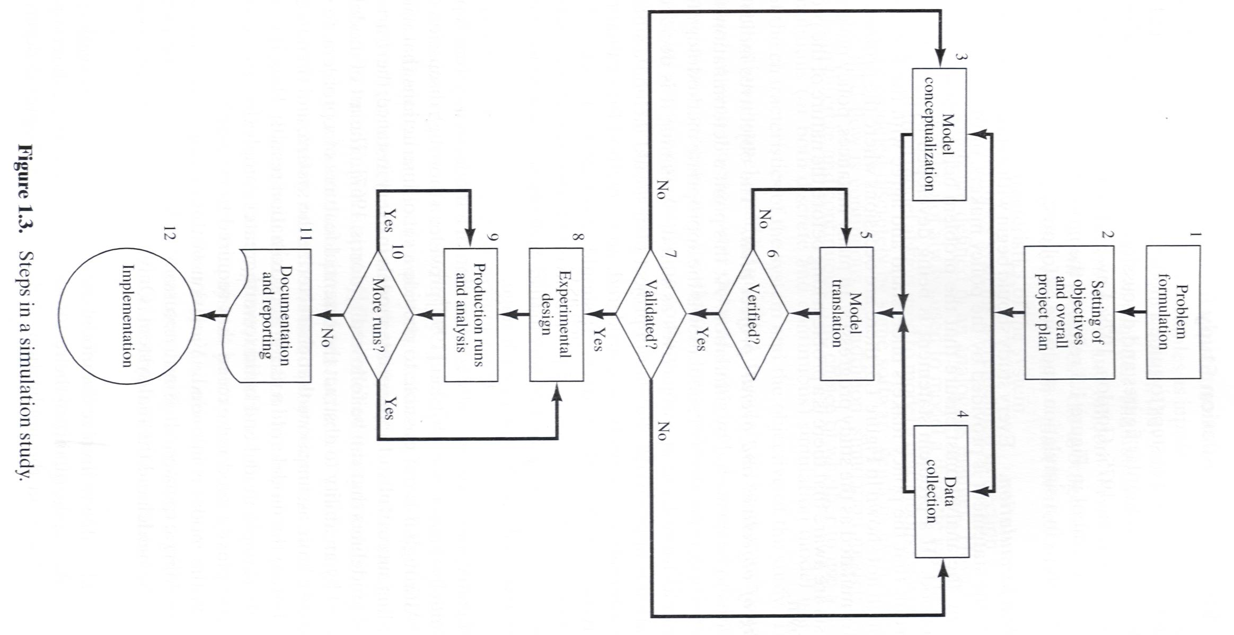

Slide 21
1.11 Steps in a Simulation Study (1)
Problem formulation
Policy maker/Analyst understand and agree with the formulation.
Setting of objectives and overall project plan
Model conceptualization
The art of modeling is enhanced by an ability to abstract the essential features of a problem, to select and modify basic assumptions that characterize the system, and then to enrich and elaborate the model until a useful approximation results.
Data collection
As the complexity of the model changes, the required data elements may also change.
Model translation
GPSS/HTM or special-purpose simulation software

Slide 22
1.11 Steps in a Simulation Study (2)
Verified?
Is the computer program performing properly?
Debugging for correct input parameters and logical structure
Validated?
The determination that a model is an accurate representation of the real system.
Validation is achieved through the calibration of the model
Experimental design
The decision on the length of the initialization period, the length of simulation runs, and the number of replications to be made of each run.
Production runs and analysis
To estimate measures of performances

Slide 23
1.11 Steps in a Simulation Study (3)
More runs?
Documentation and reporting
Program documentation : for the relationships between input parameters and output measures of performance, and for a modification
Progress documentation : the history of a simulation, a chronology of work done and decision made.
Implementation

Slide 24
1.11 Steps in a Simulation Study (4)
Four phases according to Figure 1.3
First phase : a period of discovery or orientation
(step 1, step2)
Second phase : a model building and data collection
(step 3, step 4, step 5, step 6, step 7)
Third phase : running the model
(step 8, step 9, step 10)
Fourth phase : an implementation
(step 11, step 12)

Slide 25
Ch2. Simulation Examples
Three steps of the simulations
Determine the characteristics of each of the inputs to the simulation. Quite often, these may be modeled as probability distributions, either continuous or discrete.
Construct a simulation table. Each simulation table is different, for each is developed for the problem at hand.
For each repetition i, generate a value for each of the p inputs, and evaluate the function, calculating a value of the response y_{i}. The input values may be computed by sampling values from the distributions determined in step 1. A response typically depends on the inputs and one or more previous responses.

Slide 26
The simulation table provides a systematic method for tracking system state over time.
Inputs
Response
Repetitions
X_{i1}
X_{i2}
…
X_{ij}
…
X_{ip}
y_{i}
1
2
·
·
·
n

Slide 27
2.1 Simulation of Queueing Systems (1)
Server
Waiting Line
Calling population
Fig. 2.1 Queueing System
A queueing system is described by its calling population, the nature of the arrivals, the service mechanism, the system capacity, and the queueing discipline.

Slide 28
2.1 Simulation of Queueing Systems (2)
In the single-channel queue, the calling population is infinite.
If a unit leaves the calling population and joins the waiting line or enters service, there is no change in the arrival rate of other units that may need service.
Arrivals for service occur one at a time in a random fashion.
Once they join the waiting line, they are eventually served.
Service times are of some random length according to a probability distribution which does not change over time.
The system capacity has no limit, meaning that any number of units can wait in line.
Finally, units are served in the order of their arrival (often called FIFO: First In, First out) by a single server or channel.

Slide 29
2.1 Simulation of Queueing Systems (3)
Arrivals and services are defined by the distribution of the time between arrivals and the distribution of service times, respectively.
For any simple single- or multi-channel queue, the overall effective arrival rate must be less than the total service rate, or the waiting line will grow without bound.
In some systems, the condition about arrival rate being less than service rate may not guarantee stability

Slide 30
2.1 Simulation of Queueing Systems (4)
System state : the number of units in the system and the status of the server(busy or idle).
Event : a set of circumstances that cause an instantaneous change in the state of the system.
In a single-channel queueing system there are only two possible events that can affect the state of the system.
the arrival event : the entry of a unit into the system
the departure event : the completion of service on a unit.
Simulation clock : used to track simulated time.

Slide 31
2.1 Simulation of Queueing Systems (5)
If a unit has just completed service, the simulation proceeds in the manner shown in the flow diagram of Figure 2.2.
Note that the server has only two possible states : it is either busy or idle.
Departure Event
Begin server idle time
No
Another unit waiting?
Yes
Remove the waiting unit from the queue
Begin servicing the unit
Fig. 2.2 Service-just-completed flow diagram

Slide 32
2.1 Simulation of Queueing Systems (6)
The arrival event occurs when a unit enters the system.
The unit may find the server either idle or busy.
Idle : the unit begins service immediately
Busy : the unit enters the queue for the server.
Arrival Event
Unit enters service
No
Server busy?
Yes
Unit enters queue for service
Fig. 2.3 Unit-entering-system flow diagram

Slide 33
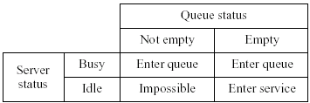
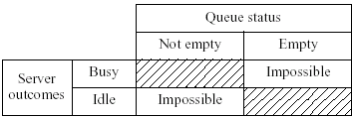
2.1 Simulation of Queueing Systems (7)
Fig. 2.4 Potential unit actions upon arrival
Fig. 2.5 Server outcomes after service completion

Slide 34
2.1 Simulation of Queueing Systems (8)
Simulations of queueing systems generally require the maintenance of an event list for determining what happens next.
Simulation clock times for arrivals and departures are computed in a simulation table customized for each problem.
In simulation, events usually occur at random times, the randomness imitating uncertainty in real life.
Random numbers are distributed uniformly and independently on the interval (0, 1).
Random digits are uniformly distributed on the set {0, 1, 2, … , 9}.
The proper number of digits is dictated by the accuracy of the data being used for input purposes.

Slide 35
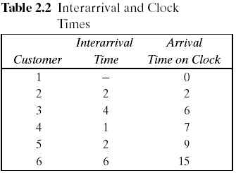
2.1 Simulation of Queueing Systems (9)
Pseudo-random numbers : the numbers are generated using a procedure → detailed in Chapter 7.
Table 2.2. Interarrival and Clock Times
Assume that the times between arrivals were generated by rolling a die five times and recording the up face.

Slide 36
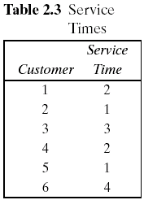
2.1 Simulation of Queueing Systems (10)
Table 2.3. Service Times
Assuming that all four values are equally likely to occur, these values could have been generated by placing the numbers one through four on chips and drawing the chips from a hat with replacement, being sure to record the numbers selected.
The only possible service times are one, two, three, and four time units.

Slide 37
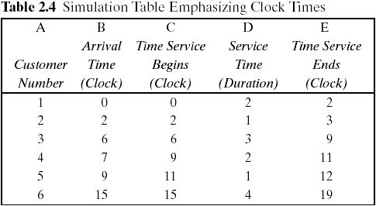
2.1 Simulation of Queueing Systems (11)
The interarrival times and service times must be meshed to simulate the single-channel queueing system.
Table 2.4 was designed specifically for a single-channel queue which serves customers on a first-in, first-out (FIFO) basis.

Slide 38
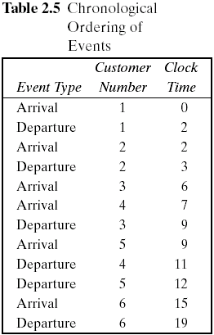
2.1 Simulation of Queueing Systems (12)
Table 2.4 keeps track of the clock time at which each event occurs.
The occurrence of the two types of events(arrival and departure event) in chronological order is shown in Table 2.5 and Figure 2.6.
Figure 2.6 is a visual image of the event listing of Table 2.5.
The chronological ordering of events is the basis of the approach to discrete-event simulation described in Chapter 3.

Slide 39
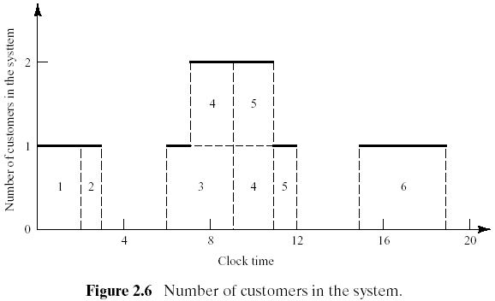
2.1 Simulation of Queueing Systems (13)
Figure 2.6 depicts the number of customers in the system at the various clock times.

Slide 40
2.1 Simulation of Queueing Systems (14)
Example 2.1 Single-Channel Queue
Assumptions
Only one checkout counter.
Customers arrive at this checkout counter at random from 1 to 8 minutes apart. Each possible value of interarrival time has the same probability of occurrence, as shown in Table 2.6.
The service times vary from 1 to 6 minutes with the probabilities shown in Table 2.7.
The problem is to analyze the system by simulating the arrival and service of 20 customers.

Slide 41
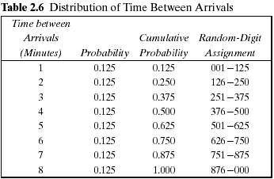
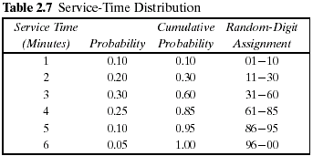
2.1 Simulation of Queueing Systems (15)

Slide 42
2.1 Simulation of Queueing Systems (16)
Example 2.1 (Cont.)
A simulation of a grocery store that starts with an empty system is not realistic unless the intention is to model the system from startup or to model until steady-state operation is reached.
A set of uniformly distributed random numbers is needed to generate the arrivals at the checkout counter. Random numbers have the following properties:
The set of random numbers is uniformly distributed between 0 and 1.
Successive random numbers are independent.
Random digits are converted to random numbers by placing a decimal point appropriately.
Table A.1 in Appendix or RAND() in Excel.
The rightmost two columns of Tables 2.6 and 2.7 are used to generate random arrivals and random service times.

Slide 43
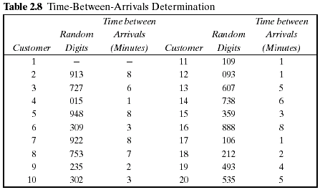
2.1 Simulation of Queueing Systems (17)
Example 2.1 (Cont.) Table 2.8
The first random digits are 913. To obtain the corresponding time between arrivals, enter the fourth column of Table 2.6 and read 8 minutes from the first column of the table.

Slide 44
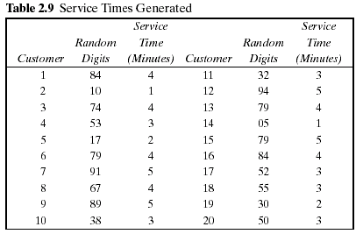
2.1 Simulation of Queueing Systems (18)
Example 2.1 (Cont.) Table 2.9
The first customer's service time is 4 minutes because the random digits 84 fall in the bracket 61-85

Slide 45
2.1 Simulation of Queueing Systems (19)
Example 2.1 (Cont.)
The essence of a manual simulation is the simulation table.
The simulation table for the single-channel queue, shown in Table 2.10, is an extension of the type of table already seen in Table 2.4.
Statistical measures of performance can be obtained form the simulation table such as Table 2.10.
Statistical measures of performance in this example.
Each customer's time in the system
The server's idle time
In order to compute summary statistics, totals are formed as shown for service times, time customers spend in the system, idle time of the server, and time the customers wait in the queue.

Slide 46
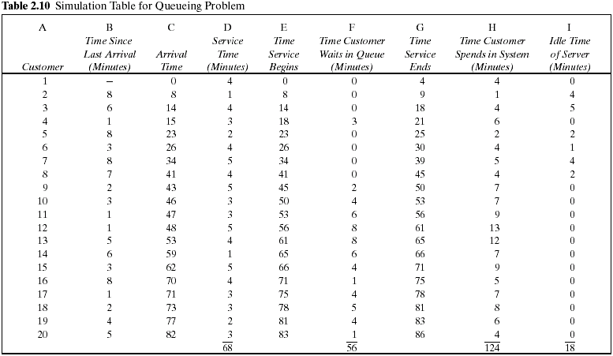

Slide 47
2.1 Simulation of Queueing Systems (20)
Example 2.1 (Cont.)
The average waiting time for a customer : 2.8 minutes
The probability that a customer has to wait in the queue : 0.65
The fraction of idle time of the server : 0.21
The probability of the server being busy: 0.79 (=1-0.21)

Slide 48
2.1 Simulation of Queueing Systems (21)
Example 2.1 (Cont.)
The average service time : 3.4 minutes
This result can be compared with the expected service time by finding the mean of the service-time distribution using the equation in table 2.7.
The expected service time is slightly lower than the average service time in the simulation. The longer the simulation, the closer the average will be to

Slide 49
2.1 Simulation of Queueing Systems (22)
Example 2.1 (Cont.)
The average time between arrivals : 4.3 minutes
This result can be compared to the expected time between arrivals by finding the mean of the discrete uniform distribution whose endpoints are a=1 and b=8.
The longer the simulation, the closer the average will be to
The average waiting time of those who wait : 4.3 minutes

Slide 50
2.1 Simulation of Queueing Systems (23)
Example 2.1 (Cont.)
The average time a customer spends in the system : 6.2 minutes
average time
customer spends
in the system
average time
customer spends
waiting in the queue
average time
customer spends
in service
=
+
∴ average time customer spends in the system = 2.8 + 3.4 = 6.2 (min)

Slide 51
2.1 Simulation of Queueing Systems (24)
Example 2.2 The Able Baker Carhop Problem
A drive-in restaurant where carhops take orders and bring food to the car.
Assumptions
Cars arrive in the manner shown in Table 2.11.
Two carhops Able and Baker - Able is better able to do the job and works a bit faster than Baker.
The distribution of their service times is shown in Tables 2.12 and 2.13.

Slide 52
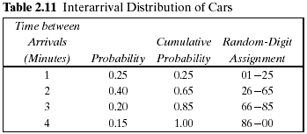
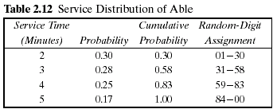
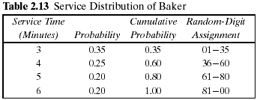
2.1 Simulation of Queueing Systems (25)
Example 2.2 (Cont.)
A simplifying rule is that Able gets the customer if both carhops are idle.
If both are busy, the customer begins service with the first server to become free.
To estimate the system measures of performance, a simulation of 1 hour of operation is made.
The problem is to find how well the current arrangement is working.

Slide 53
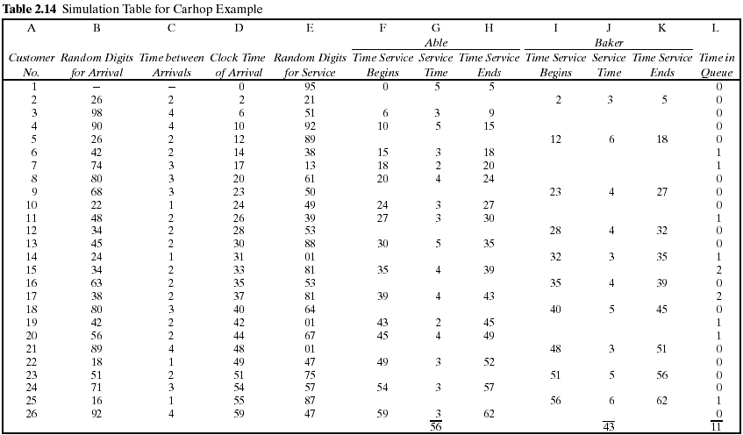

Slide 54
2.1 Simulation of Queueing Systems (26)
Example 2.2 (cont.)
The row for the first customer is filled in manually, with the random-number function RAND() in case of Excel or another random function replacing the random digits.
After the first customer, the cells for the other customers must be based on logic and formulas. For example, the “Clock Time of Arrival” (column D) in the row for the second customer is computed as follows:
D2 = D1 + C2
The logic to computer who gets a given customer can use the Excel macro function IF(), which returns one of two values depending on whether a condition is true or false.
IF( condition, value if true, value if false)

Slide 55
No
No
Yes
Nothing
Is Baker idle?
Is Able idle?
Is it time of arrival?
clock = 0
Yes
Yes
No
Yes
Baker service begin (column I)
number for service time
Generate random digit for
Able service begin (column F)
number for service time
Generate random digit for
Store clock time (column H or K)
Convert random digit to random
service (column E)
Convert random digit to random
service (column E)
Is there the service
(column J)
(column G)
completed?
No
Increment clock

Slide 56
2.1 Simulation of Queueing Systems (27)
Example 2.2 (cont.)
The logic requires that we compute when Able and Baker will become free, for which we use the built-in Excel function for maximum over a range, MAX().
If the first condition (Able idle when customer 10 arrives) is true, then the customer begins immediately at the arrival time in D10. Otherwise, a second IF() function is evaluated, which says if Baker is idle, put nothing (..) in the cell. Otherwise, the function returns the time that Able or Baker becomes idle, whichever is first [the minimum or MIN() of their respective completion times].
A similar formula applies to cell I10 for “Time Service Begins” for Baker.

Slide 57
2.1 Simulation of Queueing Systems (28)
Example 2.2 (Cont.)
For service times for Able, you could use another IF() function to make the cell blank or have a value:
G10 = IF(F10 > 0,new service time, "")
H10 = IF(F10 > 0, F10+G10, "")

Slide 58
2.1 Simulation of Queueing Systems (29)
The analysis of Table 2.14 results in the following:
Over the 62-minute period Able was busy 90% of the time.
Baker was busy only 69% of the time. The seniority rule keeps Baker less busy (and gives Able more tips).
Nine of the 26 arrivals (about 35%) had to wait. The average waiting time for all customers was only about 0.42 minute (25 seconds), which is very small.
Those nine who did have to wait only waited an average of 1.22 minutes, which is quite low.
In summary, this system seems well balanced. One server cannot handle all the diners, and three servers would probably be too many. Adding an additional server would surely reduce the waiting time to nearly zero. However, the cost of waiting would have to be quite high to justify an additional server.

Slide 59
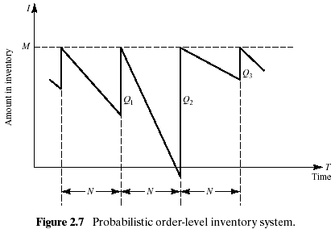
2.2 Simulation of Inventory Systems (1)
This inventory system has a periodic review of length N, at which time the inventory level is checked.
An order is made to bring the inventory up to the level M.
In this inventory system the lead time (i.e., the length of time between the placement and receipt of an order) is zero.
Demand is shown as being uniform over the time period

Slide 60
2.2 Simulation of Inventory Systems (2)
Notice that in the second cycle, the amount in inventory drops below zero, indicating a shortage.
Two way to avoid shortages
Carrying stock in inventory
: cost - the interest paid on the funds borrowed to buy the items, renting of storage space, hiring guards, and so on.
Making more frequent reviews, and consequently, more frequent purchases or replenishments
: the ordering cost
The total cost of an inventory system is the measure of performance.
The decision maker can control the maximum inventory level, M, and the length of the cycle, N.
In an (M,N) inventory system, the events that may occur are: the demand for items in the inventory, the review of the inventory position, and the receipt of an order at the end of each review period.

Slide 61
2.2 Simulation of Inventory Systems (3)
Example 2.3 The Newspaper Seller’s Problem
A classical inventory problem concerns the purchase and sale of newspapers.
The paper seller buys the papers for 33 cents each and sells them for 50 cents each. (The lost profit from excess demand is 17 cents for each paper demanded that could not be provided.)
Newspapers not sold at the end of the day are sold as scrap for 5 cents each. (the salvage value of scrap papers)
Newspapers can be purchased in bundles of 10. Thus, the paper seller can buy 50, 60, and so on.
There are three types of newsdays, “good,” “fair,” and “poor,” with probabilities of 0.35, 0.45, and 0.20, respectively.

Slide 62
2.2 Simulation of Inventory Systems (4)
Example 2.3 (Cont.)
The problem is to determine the optimal number of papers the newspaper seller should purchase.
This will be accomplished by simulating demands for 20 days and recording profits from sales each day.
The profits are given by the following relationship:
The distribution of papers demanded on each of these days is given in Table 2.15.
Tables 2.16 and 2.17 provide the random-digit assignments for the types of newsdays and the demands for those newsdays.

Slide 63
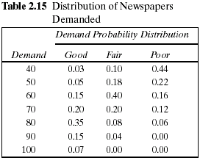
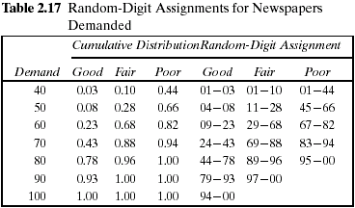
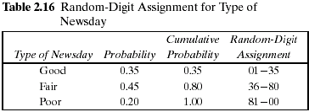
2.2 Simulation of Inventory Systems (5)

Slide 64
2.2 Simulation of Inventory Systems (6)
Example 2.3 (Cont.)
The simulation table for the decision to purchase 70 newspapers is shown in Table 2.18.
The profit for the first day is determined as follows:
Profit = $30.00 - $23.10 - 0 + $.50 = $7.40
On day 1 the demand is for 60 newspapers. The revenue from the sale of 60 newspapers is $30.00.
Ten newspapers are left over at the end of the day.
The salvage value at 5 cents each is 50 cents.
The profit for the 20-day period is the sum of the daily profits, $174.90. It can also be computed from the totals for the 20 days of the simulation as follows:
Total profit = $645.00 - $462.00 - $13.60 + $5.50 = $174.90
The policy (number of newspapers purchased) is changed to other values and the simulation repeated until the best value is found.

Slide 65
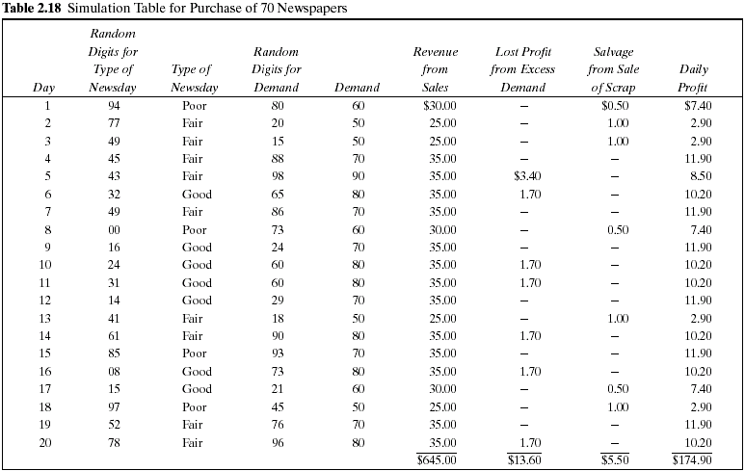

Slide 66
2.2 Simulation of Inventory Systems (7)
Example 2.4 Simulation of an (M,N) Inventory System
This example follows the pattern of the probabilistic order-level inventory system shown in Figure 2.7.
Suppose that the maximum inventory level, M, is 11 units and the review period, N, is 5 days. The problem is to estimate, by simulation, the average ending units in inventory and the number of days when a shortage condition occurs.
The distribution of the number of units demanded per day is shown in Table 2.19.
In this example, lead time is a random variable, as shown in Table 2.20.
Assume that orders are placed at the close of business and are received for inventory at the beginning of business as determined by the lead time.

Slide 67
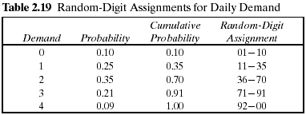
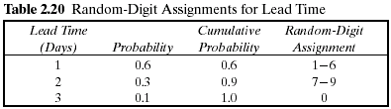
2.2 Simulation of Inventory Systems (8)
Example 2.4 (Cont.)
For purposes of this example, only five cycles will be shown.
The random-digit assignments for daily demand and lead time are shown in the rightmost columns of Tables 2.19 and 2.20.

Slide 68
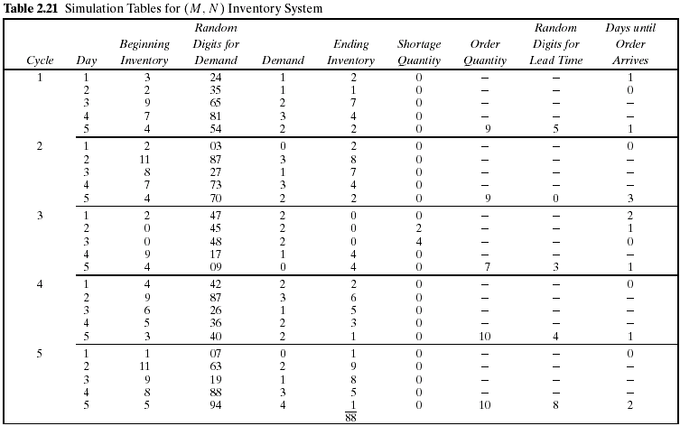

Slide 69
2.2 Simulation of Inventory Systems (9)
Example 2.4 (Cont.)
The simulation has been started with the inventory level at 3 units and an order of 8 units scheduled to arrive in 2 days' time.
Beginning Inventory of Third day
Ending Inventory of 2 day in first cycle
=
+
new order
The lead time for this order was 1 day.
Notice that the beginning inventory on the second day of the third cycle was zero. An order for 2 units on that day led to a shortage condition. The units were backordered on that day and the next day also. On the morning of day 4 of cycle 3 there was a beginning inventory of 9 units. The 4 units that were backordered and the 1 unit demanded that day reduced the ending inventory to 4 units.
Based on five cycles of simulation, the average ending inventory is approximately 3.5 (88 ÷ 25) units. On 2 of 25 days a shortage condition existed.

Slide 70
2.3 Other Examples of Simulation (1)
Example 2.5 A Reliability Problem
Downtime for the mill is estimated at $5 per minute.
The direct on-site cost of the repairperson is $15 per hour.
It takes 20 minutes to change one bearing, 30 minutes to change two bearings, and 40 minutes to change three bearings.
The bearings cost $16 each.
A proposal has been made to replace all three bearings whenever a bearing fails.

Slide 71
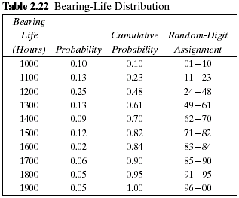
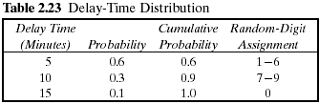
2.3 Other Examples of Simulation (2)
Example 2.5 (Cont.)
The delay time of the repairperson's arriving at the milling machine is also a random variable, with the distribution given in Table 2.23.
The cumulative distribution function of the life of each bearing is identical, as shown in Table 2.22.

Slide 72
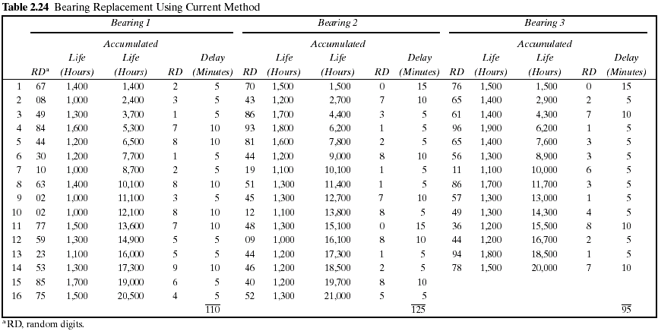

Slide 73
2.3 Other Examples of Simulation (3)
Example 2.5 (Cont.)
Table 2.24 represents a simulation of 20,000 hours of operation under the current method of operation.
Note that there are instances where more than one bearing fails at the same time.
This is unlikely to occur in practice and is due to using a rather coarse grid of 100 hours.
It will be assumed in this example that the times are never exactly the same, and thus no more than one bearing is changed at any breakdown. Sixteen bearing changes were made for bearings 1 and 2, but only 14 bearing changes were required for bearing 3.

Slide 74
2.3 Other Examples of Simulation (4)
Example 2.5 (Cont.)
The cost of the current system is estimated as follows:
Cost of bearings = 46 bearings × $16/bearing = $736
Cost of delay time = (110 + 125 + 95) minutes × $5/minute = $1650
Cost of downtime during repair =
46 bearings × 20 minutes/bearing × $5/minute = $4600
Cost of repairpersons =
46 bearings × 20 minutes/bearing × $15/60 minutes = $230
Total cost = $736 + $1650 + $4600 + $230 = $7216
Table 2.25 is a simulation using the proposed method. Notice that bearing life is taken from Table 2.24, so that for as many bearings as were used in the current method, the bearing life is identical for both methods.

Slide 75
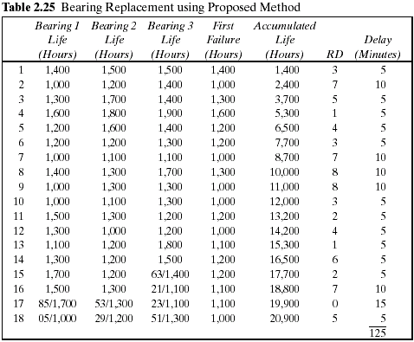

Slide 76
2.3 Other Examples of Simulation (5)
Example 2.5 (Cont.)
Since the proposed method uses more bearings than the current method, the second simulation uses new random digits for generating the additional lifetimes.
The random digits that lead to the lives of the additional bearings are shown above the slashed line beginning with the 15th replacement of bearing 3.
The total cost of the new policy :
Cost of bearings = 54 bearings × $16/bearing = $864
Cost of delay time = 125 minutes × $5/minute = $625
Cost of downtime during repairs = 18 sets × 40 minutes/set × $5/minute = $3600
Cost of repairpersons = 18 sets × 40 minutes/set × $15/60 minutes = $180
Total cost = $864 + $625 + $3600 + $180 = $5269
The new policy generates a savings of $1947 over a 20,000-hour simulation. If the machine runs continuously, the simulated time is about 2 1/4 years. Thus, the savings are about $865 per year.

Slide 77
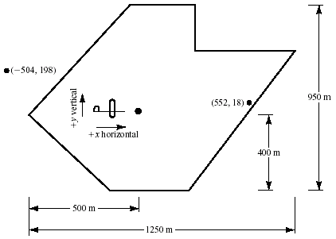
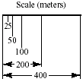
2.3 Other Examples of Simulation (6)
Example 2.6 Random Normal Numbers
A classic simulation problem is that of a squadron of bombers attempting to destroy an ammunition depot shaped as shown in Figure 2.8.

Slide 78
2.3 Other Examples of Simulation (7)
Example 2.6 (Cont.)
If a bomb lands anywhere on the depot, a hit is scored. Otherwise, the bomb is a miss.
The aircraft fly in the horizontal direction.
Ten bombers are in each squadron.
The aiming point is the dot located in the heart of the ammunition dump.
The point of impact is assumed to be normally distributed around the aiming point with a standard deviation of 600 meters in the horizontal direction and 300 meters in the vertical direction.
The problem is to simulate the operation and make statements about the number of bombs on target.

Slide 79
2.3 Other Examples of Simulation (8)
Example 2.6 (Cont.)
The standardized normal variate, Z, with mean 0 and standard deviation 1, is distributed as
where X is a normal random variable, is the true mean of the distribution of X, and is the standard deviation of X.
In this example the aiming point can be considered as (0, 0); that is, the value in the horizontal direction is 0, and similarly for the value in the vertical direction.
where (X,Y) are the simulated coordinates of the bomb after it has fallen
and

Slide 80
2.3 Other Examples of Simulation (9)
Example 2.6 (Cont.)
The values of Z are random normal numbers.
These can be generated from uniformly distributed random numbers, as discussed in Chapter 7.
Alternatively, tables of random normal numbers have been generated. A small sample of random normal numbers is given in Table A.2.
For Excel, use the Random Number Generation tool in the Analysis TookPak Add-In to generate any number of normal random values in a range of cells.
The table of random normal numbers is used in the same way as the table of random numbers.
Table 2.26 shows the results of a simulated run.

Slide 81
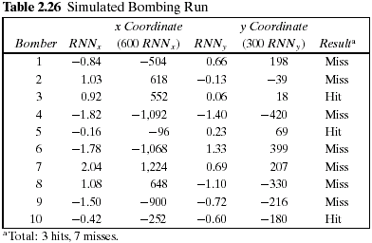
2.3 Other Examples of Simulation (10)
Example 2.6 (Cont.)

Slide 82
2.3 Other Examples of Simulation (11)
Example 2.6 (Cont.)
The mnemonic stands for .random normal number to compute the x coordinate. and corresponds to above.
The first random normal number used was –0.84, generating an x coordinate 600(-0.84) = -504.
The random normal number to generate the y coordinate was 0.66, resulting in a y coordinate of 198.
Taken together, (-504, 198) is a miss, for it is off the target.
The resulting point and that of the third bomber are plotted on Figure 2.8.
The 10 bombers had 3 hits and 7 misses.
Many more runs are needed to assess the potential for destroying the dump.
This is an example of a Monte Carlo, or static, simulation, since time is not an element of the solution.

Slide 83
2.3 Other Examples of Simulation (12)
Example 2.7 Lead-Time Demand
Lead-time demand may occur in an inventory system.
The lead time is the time from placement of an order until the order is received.
In a realistic situation, lead time is a random variable.
During the lead time, demands also occur at random. Lead-time demand is thus a random variable defined as the sum of the demands over the lead time, or
where i is the time period of the lead time, i = 0, 1, 2, … , D_{i} is the demand during the i^{th} time period; and T is the lead time.
The distribution of lead-time demand is determined by simulating many cycles of lead time and building a histogram based on the results.

Slide 84
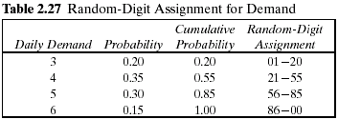

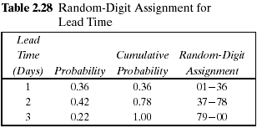

2.3 Other Examples of Simulation (13)
Example 2.7 (Cont.)
The daily demand is given by the following probability distribution:
The lead time is a random variable given by the following distribution:

Slide 85
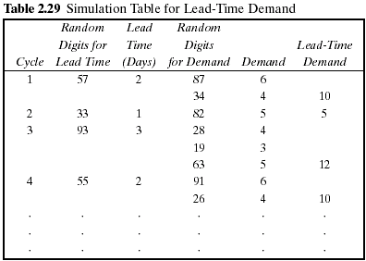
2.3 Other Examples of Simulation (14)
Example 2.7 (Cont.)
The incomplete simulation table is shown in Table 2.29.
The random digits for the first cycle were 57. This generates a lead time of 2 days.
Thus, two pairs of random digits must be generated for the daily demand.

Slide 86
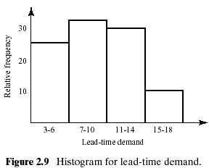
2.3 Other Examples of Simulation (15)
Example 2.7 (Cont.)
The histogram might appear as shown in Figure 2.9.
This example illustrates how simulation can be used to study an unknown distribution by generating a random sample from the distribution.

Slide 87
2.4 Summary
This chapter introduced simulation concepts via examples in order to illustrate general areas of application and to motivate the remaining chapters.
The next chapter gives a more systematic presentation of the basic concepts. A more systematic methodology, such as the event-scheduling approach described in Chapter 3, is needed.
Ad hoc simulation tables were used in completing each example. Events in the tables were generated using uniformly distributed random numbers and, in one case, random normal numbers.
The examples illustrate the need for determining the characteristics of the input data, generating random variables from the input models, and analyzing the resulting response.

Slide 88
Ch. 3 General Principles
Discrete-event simulation
The basic building blocks of all discrete-event simulation models
: entities and attributes, activities and events.
A system is modeled in terms of
its state at each point in time
the entities that pass through the system and the entities that represent system resources
the activities and events that cause system state to change.
Discrete-event models are appropriate for those systems for which changes in system state occur only at discrete points in time.
This chapter deals exclusively with dynamic, stochastic systems (i.e., involving time and containing random elements) which change in a discrete manner.

Slide 89
3.1Concepts in Discrete-Event Simulation (1)
System : A collection of entities (e.g., people and machines) that interact
together over time to accomplish one or more goals.
Model : An abstract representation of a system, usually containing
structural, logical, or mathematical relationships which describe a
system in terms of state, entities and their attributes, sets, processes,
events, activities, and delays.
System state : A collection of variables that contain all the information
necessary to describe the system at any time.
Entity : Any object or component in the system which requires explicit
representation in the model (e.g., a server, a customer, a machine).
Attributes : The properties of a given entity (e.g., the priority of a waiting
customer, the routing of a job through a job shop).

Slide 90
3.1Concepts in Discrete-Event Simulation (2)
List : A collection of (permanently or temporarily) associated entities, ordered
in some logical fashion (such as all customers currently in a waiting line,
ordered by first come, first served, or by priority).
Event : An instantaneous occurrence that changes the state of a system
(such as an arrival of a new customer).
Event notice : A record of an event to occur at the current or some future
time, along with any associated data necessary to execute the
event; at a minimum, the record includes the event type and
the event time.
Event list : A list of event notices for future events, ordered by time of
occurrence also known as the future event list (FEL).
Activity : A duration of time of specified length (e.g., a service time or
interarrival time), which is known when it begins (although it may be
defined in terms of a statistical distribution).

Slide 91
3.1Concepts in Discrete-Event Simulation (3)
Delay : A duration of time of unspecified indefinite length, which is not
known until it ends (e.g., a customer's delay in a last-in, first-out
waiting line which, when it begins, depends on future arrivals).
Clock : A variable representing simulated time, called CLOCK in the
examples to follow.
An activity typically represents a service time, an interarrival time, or any other processing time whose duration has been characterized and defined by the modeler.
An activity's duration may be specified in a number of ways:
1. Deterministic-for example, always exactly 5 minutes;
2. Statistical-for example, as a random draw from among 2, 5, 7 with equal
probabilities;
3. A function depending on system variables and/or entity attributes-for example,
loading time for an iron ore ship as a function of the ship's allowed cargo
weight and the loading rate in tons per hour.

Slide 92
3.1Concepts in Discrete-Event Simulation (4)
an end of inspection event
event time = 105
Event notice
100
105
time
current simulated time
Inspection time (=5)
The duration of an activity is computable from its specification at the instant it begins.
To keep track of activities and their expected completion time, at the simulated instant that an activity duration begins, an event notice is created having an event time equal to the activity's completion time.

Slide 93
3.1Concepts in Discrete-Event Simulation (5)
A delay's duration
Not specified by the modeler ahead of time, But rather determined by system conditions.
Quite often, a delay's duration is measured and is one of the desired outputs of a model run.
A customer's delay in a waiting line may be dependent on the number and duration of service of other customers ahead in line as well as the availability of servers and equipment.

Slide 94
3.1Concepts in Discrete-Event Simulation (6)
 | Delay | Activity
What so called | a conditional wait | an unconditional wait
A completion | a secondary event | a primary event
A management | by placing an event notice on the FEL | by placing the associated entity on another list, not the FEL, perhaps repre-senting a waiting line
System state, entity attributes and the number of active entities, the
contents of sets, and the activities and delays currently in progress are all
functions of time and are constantly changing over time.
Time itself is represented by a variable called CLOCK.

Slide 95
3.1Concepts in Discrete-Event Simulation (7)
EXAMPLE 3.1 (Able and Baker, Revisited)
Consider the Able-Baker carhop system of Example 2.2.
System state
: the number of cars waiting to be served at time t
: 0 or 1 to indicate Able being idle or busy at time t
: 0 or 1 to indicate Baker being idle or busy at time t
Entities : Neither the customers (i.e., cars) nor the servers need
to be explicitly represented, except in terms of the
state variables, unless certain customer averages are
desired (compare Examples 3.4 and 3.5)
Events
Arrival event
Service completion by Able
Service completion by Baker

Slide 96
3.1Concepts in Discrete-Event Simulation (8)
EXAMPLE 3.1 (Cont.)
Activities
Interarrival time, defined in Table 2.11
Service time by Able, defined in Table 2.12
Service time by Baker, defined in Table 2.13
Delay : A customer's wait in queue until Able or Baker becomes free
The definition of the model components provides a static description of the model.
A description of the dynamic relationships and interactions between the components is also needed.

Slide 97
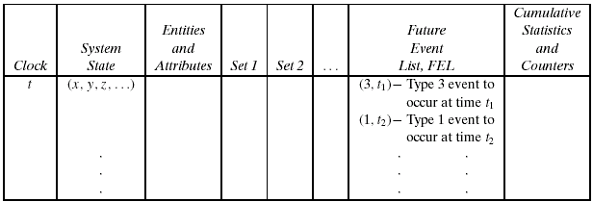
3.1Concepts in Discrete-Event Simulation (9)
A discrete-event simulation
: the modeling over time of a system all of whose state changes occur
at discrete points in time-those points when an event occurs.
A discrete-event simulation proceeds by producing a sequence of system snapshots (or system images) which represent the evolution of the system through time.
Figure 3.1 Prototype system snapshot at simulation time t

Slide 98
3.1.1. The Event-Scheduling/Time-Advanced Algorithm (1)
The mechanism for advancing simulation time and guaranteeing that all events occur in correct chronological order is based on the future event list (FEL).
Future Event List (FEL)
to contain all event notices for events that have been scheduled to occur at a future time.
to be ordered by event time, meaning that the events are arranged chronologically; that is, the event times satisfy
Scheduling a future event means that at the instant an activity begins, its duration is computed or drawn as a sample from a statistical distribution and the end-activity event, together with its event time, is placed on the future event list.
current value of simulated time
Imminent event

Slide 99
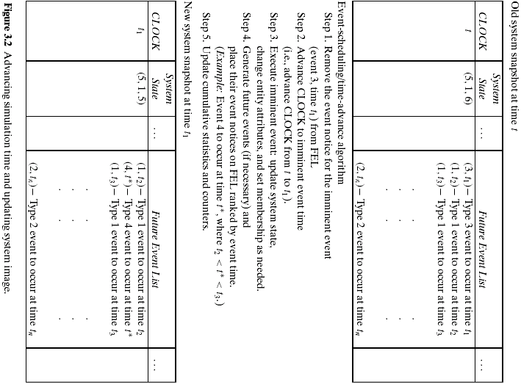

Slide 100
3.1.1. The Event-Scheduling/Time-Advanced Algorithm (2)
List processing : the management of a list .
the removal of the imminent event
: As the imminent event is usually at the top of the list, its removal is as
efficient as possible.
the addition of a new event to the list, and occasionally removal of some event (called cancellation of an event)
: Addition of a new event (and cancellation of an old event) requires a
search of the list.
The efficiency of this search depends on the logical organization of the list and on how the search is conducted.
The removal and addition of events from the FEL is illustrated in Figure 3.2.

Slide 101
3.1.1. The Event-Scheduling/Time-Advanced Algorithm (3)
The system snapshot at time 0 is defined by the initial conditions and the generation of the so-called exogenous events.
An exogenous event : a happening “outside the system” which
impinges on the system.
The specified initial conditions define the system state at time 0.
In Figure 3.2, if t = 0, then the state (5, 1, 6) might represent the initial number of customers at three different points in the system.
How future events are generated?
to generate an arrival to a queueing system
by a service-completion event in a queueing simulation
to generate runtimes and downtimes for a machine subject to breakdowns

Slide 102
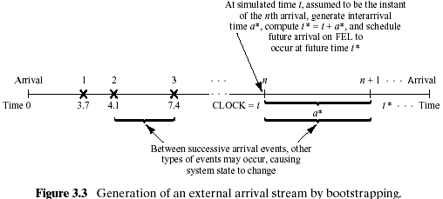
3.1.1. The Event-Scheduling/Time-Advanced Algorithm (4)
To generate an arrival to a queueing system
- The end of an interarrival interval is an example of a primary event.

Slide 103
3.1.1. The Event-Scheduling/Time-Advanced Algorithm (5)
By a service-completion event in a queueing simulation
A new service time, s*, will be generated for the next customer.
When one customer completes service, at current time CLOCK = t
If the next customer is present
⇒ The next service-completion event will be scheduled to occur at future
time t* = t + s* by placing onto the FEL a new event notice of type service
completion.
A service-completion event will be generated and scheduled at the
time of an arrival event, provided that, upon arrival, there is at least one
idle server in the server group.
Beginning service : a conditional event triggered only on the condition
that a customer is present and a server is free.
Service completion : a primary event.
Service time : an activity

Slide 104
3.1.1. The Event-Scheduling/Time-Advanced Algorithm (6)
By a service-completion event in a queueing simulation (Cont.)
A conditional event is triggered by a primary event occurring
Only primary events appear on the FEL.
To generate runtimes and downtimes for a machine subject to
breakdowns
At time 0, the first runtime will be generated and an end-of-runtime
event scheduled.
Whenever an end-of-runtime event occurs, a downtime will be
generated and an end-of-downtime event scheduled on the FEL.
When the CLOCK is eventually advanced to the time of this end-of-
downtime event, a runtime is generated and an end-of-runtime event
scheduled on the FEL.
An end of runtime and an end of downtime : primary events.
A runtime and a downtime : activities

Slide 105
3.1.1. The Event-Scheduling/Time-Advanced Algorithm (7)
Every simulation must have a stopping event, here called E, which defines
how long the simulation will run.
There are generally two ways to stop a simulation:
1. At time 0, schedule a stop simulation event at a specified future time T_{E}.
Ex) Simulate a job shop for T_{E} = 40 hours,that is,over the time interval [0, 40].
2. Run length T_{E} is determined by the simulation itself. Generally, T_{E} is the time of
occurrence of some specified event E.
Ex) the time of the 100th service completion at a certain service center.
the time of breakdown of a complex system.
the time of disengagement or total kill in a combat simulation.
the time at which a distribution center ships the last carton in a day's orders.
In case 2, T_{E} is not known ahead of time. Indeed, it may be one of the
statistics of primary interest to be produced by the simulation.

Slide 106
3.1.2. World Views (1)
World views
: the event-scheduling world view, the process-interaction world view, and the
activity-scanning world view.
The process-interaction approach
To focus on entities and their life cycle
Process : the life cycle of one entity
: a time-sequenced list of events, activities, and delays, including
demands for resources, that define the life cycle of one entity
as it moves through a system.
The life cycle consists of various events and activities.
Some activities may require the use of one or more resources whose
capacities are limited (queueing).

Slide 107
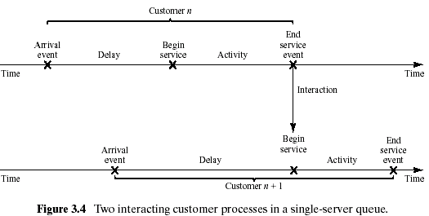
3.1.2. World Views (2)
The process-interaction approach (Cont.)
Figure 3.4 shows the interaction between two customer processes as customer n+1 is delayed until the previous customer's “end-service event” occurs.

Slide 108
3.1.2. World Views (3)
The activity-scanning approach
Simple in concept, but slow runtime on computers
: Both the event-scheduling and the process-interaction approaches
use a variable time advance.
: The activity-scanning approach uses a fixed time increment and
a rule-based approach to decide whether any activities can begin
at each point in simulated time.
To focus on the activities and those conditions
At each clock advance, the conditions for each activity are checked and,
if the conditions are true, then the corresponding activity begins.
Three-phase approach
: to combine pure activity-scanning approach with the features of event
scheduling, variable time advance.
: events are considered to be activities of duration-zero time units.

Slide 109
3.1.2. World Views (4)
The activity-scanning approach (Cont.)
In the three-phase approach, activities are divided into two categories.
- B activities : activities bound to occur; all primary events and
unconditional activities.
- C activities : activities or events that are conditional upon certain
conditions being true.
Phase A : Remove the imminent event from the FEL and advance the clock
to its event time. Remove any other events from the FEL that
have the same event time.
Phase B : Execute all B-type events that were removed from the FEL.
Phase C : Scan the conditions that trigger each C-type activity and
activate any whose conditions are met. Rescan until no
additional C-type activities can begin or events occur.

Slide 110
3.1.2. World Views (5)
EXAMPLE 3.2 (Able and Baker, Back Again)
The events and activities were identified in Example 3.1.
Using the three-phase approach, the conditions for beginning each activity in Phase C are:
Using the process-interaction approach, we view the model from the viewpoint of a customer and its “life cycle.” Considering a life cycle beginning upon arrival, a customer process is pictured in Figure 3.4
Activity | Condition
Service time by Able | A customer is in queue and Able is idle
Service time by Baker | A customer is in queue, Baker is idle, and Able is busy

Slide 111
3.1.3. Manual Simulation Using Event Scheduling (1)
Example 3.3 (Single-Channel Queue)
Reconsider Example 2.1
System state (LQ(t), LS(t)) :
LQ(t) is the number of customers in the waiting line
LS(t) is the number being served (0 or 1) at time t
Entities : The server and customers are not explicitly modeled,
except in terms of the state variables above.
Events :
Arrival (A)
Departure (D)
Stopping event (E), scheduled to occur at time 60.

Slide 112
3.1.3. Manual Simulation Using Event Scheduling (2)
Example 3.3 (Cont.)
Event notices (event type, event time) :
(A, t ), representing an arrival event to occur at future time t
(D, t ), representing a customer departure at future time t
(E, 60), representing the simulation-stop event at future time 60.
Activities :
Interarrival time, defined in Table 2.6
Service time, defined in Table 2.7
Delay : Customer time spent in waiting line.
The effect of the arrival and departure events was first shown in Figures 2.2 and 2.3 and is shown in more detail in Figures 3.5 and 3.6.

Slide 113
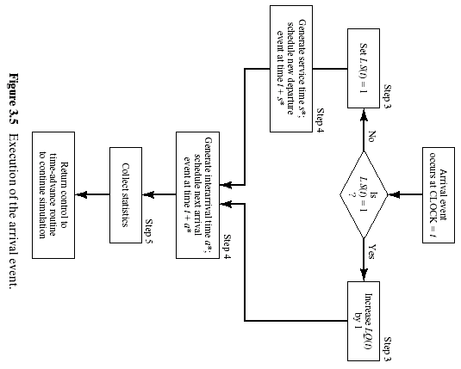

Slide 114
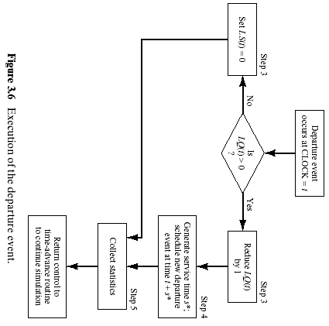

Slide 115

3.1.3. Manual Simulation Using Event Scheduling (3)
Example 3.3 (Cont.)
The interarrival times and service times will be identical to those used in Table 2.10
Initial conditions
the system snapshot at time zero (CLOCK = 0)
LQ(0) = 0, LS(0) = 1
both a departure event and arrival event on the FEL.
The simulation is scheduled to stop at time 60.
Server utilization : total server busy time (B) / total time (T_{E}).
a* : the generated interarrival time
s* : the generated service times
The simulation in Table 3.1 covers the time interval [0, 21].

Slide 116
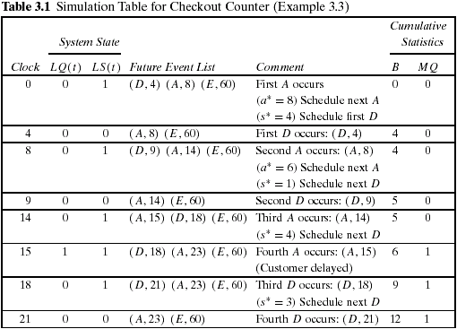
3.1.3. Manual Simulation Using Event Scheduling (4)

Slide 117
3.1.3. Manual Simulation Using Event Scheduling (5)
Example 3.4 (The Checkout-Counter Simulation, Continued)
In Example 3.3, to estimate :
mean response time : the average length of time a customer spends
in the system
mean proportion of customers who spend 4 or more minutes in the system.
Entities (Ci, t ) : representing customer Ci who arrived at time t
Event notices :
(A, t, Ci), the arrival of customer Ci at future time t
(D, t, Cj), the departure of customer Cj at future time t
Set : “CHECKOUTLINE,” the set of all customers currently
at the checkout counter (being served or waiting to be
served), ordered by time of arrival
A customer entity with arrival time as an attribute is added in order to estimate mean response time.

Slide 118
3.1.3. Manual Simulation Using Event Scheduling (6)
Example 3.4 (Cont.)
Three new cumulative statistics will be collected :
S : the sum of customer response times for all customers who have
departed by the current time
F : the total number of customers who spend 4 or more minutes at
the checkout counter
N_{D} : the total number of departures up to the current simulation time.
These three cumulative statistics will be updated whenever the
departure event occurs.
The simulation table for Example 3.4 is shown in Table 3.2.
The response time for customer is computed by
Response time = CLOCK TIME - attribute “time of arrival”

Slide 119
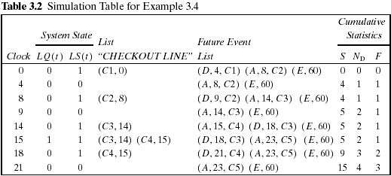
3.1.3. Manual Simulation Using Event Scheduling (7)
Example 3.4 (Cont.)
For a simulation run length of 21 minutes
the average response time was S/N_{D} = 15/4 = 3.75 minutes
the observed proportion of customers who spent 4 or more minutes in the system was F/N_{D} = 0.75.

Slide 120
3.1.3. Manual Simulation Using Event Scheduling (8)
Example 3.5 (The Dump Truck Problem, Figure 3.7)
Traveling
Loading
Scale
Loader
Weighing
queue
queue
First-Come First-Served
First-Come First-Served
The distributions of loading time, weighing time, and travel time are given in Tables 3.3, 3.4, and 3.5, respectively, from Table A.1.
The purpose of the simulation is to estimate the loader and scale utilizations (percentage of time busy).

Slide 121
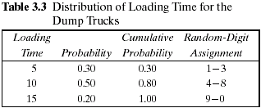
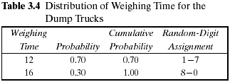


3.1.3. Manual Simulation Using Event Scheduling (9)
The activity times are taken from the following list as needed:

Slide 122
3.1.3. Manual Simulation Using Event Scheduling (10)
Example 3.5 (Cont.)
System state [LQ(t), L(t), WQ(t), W(t)]
LQ(t) = number of trucks in loader queue
L(t) = number of trucks (0, 1, or 2) being loaded
WQ(t) = number of trucks in weigh queue
W(t) = number of trucks (0 or 1) being weighed, all at simulation
time t
Event notices :
(ALQ, t, DTi ), dump truck i arrives at loader queue (ALQ) at time t
(EL, t, DTi), dump truck i ends loading (EL) at time t
(EW, t, DTi), dump truck i ends weighing (EW) at time t
Entities : The six dump trucks (DT 1, … , DT 6)

Slide 123
3.1.3. Manual Simulation Using Event Scheduling (11)
Example 3.5 (Cont.)
Lists :
Loader queue : all trucks waiting to begin loading, ordered on
a first come, first served basis
Weigh queue : all trucks waiting to be weighed, ordered on a first
come, first served basis
Activities : Loading time, weighing time, and travel time
Delays : Delay at loader queue, and delay at scale
It has been assumed that five of the trucks are at the loaders and one is at the scale at time 0.
The simulation table is given in Table 3.6.

Slide 124


Slide 125


Slide 126
3.1.3. Manual Simulation Using Event Scheduling (12)
Example 3.5 (Cont.)
This logic for the occurrence of the end-loading event
When an end-loading (EL) event occurs, say for truck j at time t , other events may be triggered.
If the scale is idle [W(t)=0], truck j begins weighing and an end-weighing event (EW) is scheduled on the FEL.
Otherwise, truck j joins the weigh queue.
If at this time there is another truck waiting for a loader, it will be removed from the loader queue and will begin loading by the scheduling of an end-loading event (EL) on the FEL.
In order to estimate the loader and scale utilizations, two cumulative statistics are maintained:
B_{L} = total busy time of both loaders from time 0 to time t
B_{S} = total busy time of the scale from time 0 to time t

Slide 127
3.1.3. Manual Simulation Using Event Scheduling (13)
Example 3.5 (Cont.)
The utilizations are estimated as follows:
average loader utilization
average scale utilization
These estimates cannot be regarded as accurate estimates of the long-run “steady-state” utilizations of the loader and scale.
A considerably longer simulation would be needed to reduce the effect of the assumed conditions at time 0 (five of the six trucks at the loaders) and to realize accurate estimates.

Slide 128

3.1.3. Manual Simulation Using Event Scheduling (14)
Example 3.6 (The Dump Truck Problem Revisited)
The events and activities were identified in Example 3.5.
Using the activity scanning approach
Using the process-interaction approach
Activity | Condition
Loading time | Truck is at front of loader queue, and at least one loader is idle.
Weighing time | Truck is at front of weigh queue and weigh scale is idle.
Travel time | Truck has just completed weighing.

Slide 129
3.2 List Processing
3.2.1 List : Basic Properties and Operations (1)
Head Pointer
Event type
Event type
Event type
Event type
Event time
Event time
Event time
Event time
Any data
Any data
Any data
Any data
Next pointer
Next pointer
Next pointer
Next pointer
Record
Record
Record
Tail Pointer
List : a set of ordered or ranked records.
Record : one entity or one event notice.
Field : an entity identifier and its attributes
: the event type, event time, and any other event
related data

Slide 130
3.2.1 List : Basic Properties and Operations (2)
How to store record in a physical location in computer memory
in arrays : successive records in contiguous locations
by pointers to a record : structures in C, classes in C++
The main operations on a list :
Removing a record from the top of the list.
when time is advanced and the imminent event is due to be executed.
by adjusting the head pointer on the FEL ⇔ by removing the event at the top of the FEL.
Removing a record from any location on the list.
If an arbitrary event is being canceled, or an entity is removed from a list based on some of its attributes (say, for example, its priority and due date) to begin an activity.
by making a partial search through the list.

Slide 131
3.2.1 List : Basic Properties and Operations (3)
The main operations on a list (Cont.)
Adding an entity record to the top or bottom of the list.
when an entity joins the back of a first-in first-out queue.
by adjusting the tail pointer on the FEL ⇔ by adding an entity to the bottom of the FEL
Adding a record to an arbitrary position on the list, determined
by the ranking rule.
if a queue has a ranking rule of earliest due date first (EDF).
by making a partial search through the list.
The goal of list-processing techniques
: to make second and fourth operations efficient

Slide 132
3.2.2 Using Arrays for List Processing (1)
The notation R(i) : the i^{th} record in the array
Advantage
Any specified record, say the i^{th}, can be retrieved quickly without searching, merely by referencing R(i ).
Disadvantage
When items are added to the middle of a list or the list must be rearranged.
Arrays typically have a fixed size, determined at compile time or upon initial allocation when a program first begins to execute.
In simulation, the maximum number of records for any list may be difficult or impossible to determine ahead of time, while the current number in a list may vary widely over the course of the simulation run.

Slide 133
3.2.2 Using Arrays for List Processing (2)
Memory address
100
101
102
103
104
105
106
107
108
109
110
1
2
3
4
5
7
8
9
10
adding
6
100
101
102
103
104
105
106
107
108
109
110
1
2
3
4
5
6
7
8
9
10
move
move
move
move
Two methods for keeping track of the ranking of records in a list
to store the first record in R(1), the second in R(2), and so on, and the last in R(tailptr), where tailptr is used to refer to the last item in the list.
a variable called a head pointer, with name headptr, points to the record at the top of the list.

Slide 134

3.2.2 Using Arrays for List Processing (3)
Example 3.7 (A List for the Dump Trucks at the Weigh Queue)
In Example 3.5, suppose that a waiting line of three dump trucks occurred at the weigh queue, at CLOCK time 10 in Table 3.6.
Suppose further that the model is tracking one attribute of each dump truck, its arrival time at the weigh queue, updated each time it arrives.
Suppose that the entities are stored in records in an array dimensioned from 1 to 6, one record for each dump truck.

Slide 135
3.2.2 Using Arrays for List Processing (4)
Example 3.7 (Cont.)
Each entity is represented by a record with 3 fields, the first an entity identifier, the second the arrival time at the weigh queue, and the last a pointer field to “point to” the next record, if any, in the list representing the weigh queue, as follows:
[ DTi , arrival time at weigh queue, next index ]
At CLOCK time 10, the list of entities in the weigh queue would be defined by:
headptr = 3
R(1) = [DT1, 0.0, 0]
R(2) = [DT2, 10.0, 4]
R(3) = [DT3, 5.0, 2]
R(4) = [DT4, 10.0, 0]
R(5) = [DT5, 0.0, 0]
R(6) = [DT6, 0.0, 0]
tailptr = 4

Slide 136
3.2.2 Using Arrays for List Processing (5)
Example 3.7 (Cont.)
To traverse the list, start with the head pointer, go to that record, retrieve that record's next pointer, and proceed, to create the list in its logical order, as for example:
headptr = 3
R(3) = [DT3, 5.0, 2]
R(2) = [DT2, 10.0, 4]
R(4) = [DT4, 10.0, 0]
tailptr = 4

Slide 137


3.2.2 Using Arrays for List Processing (6)
Example 3.7 (Cont.)
At CLOCK time 12, dump truck DT 3 begins weighing and thus leaves the weigh queue.
headptr = 2
At CLOCK time 20, dump truck DT 5 arrives to the weigh queue and joins the rear of the queue.
tailptr = 5

Slide 138
3.2.3 Using Dynamic Allocation and Linked Lists (1)
In procedural languages such as C and C++, and in most simulation languages, entity records are dynamically created when an entity is created and event notice records are dynamically created whenever an event is scheduled on the future event list.
The languages themselves, or the operating systems on which they are running, maintain a linked list of free chunks of computer memory and allocate a chunk of desired size upon request to running programs.
With dynamic allocation, a record is referenced by a pointer instead of an array index. A pointer to a record can be thought of as the physical or logical address in computer memory of the record.

Slide 139
3.2.3 Using Dynamic Allocation and Linked Lists (2)
In our example, we will use a notation for records identical to that in the previous section (3.2.2):
Entities: [ ID, attributes, next pointer ]
Event notices: [ event type, event time, other data, next pointer ]
If for some reason we wanted the third item on the list, we would have to traverse the list, counting items until we reached the third record.
Unlike arrays, there is no way to retrieve directly the i^{th} record in a linked list, as the actual records may be stored at any arbitrary location in computer memory and are not stored contiguously as are arrays.

Slide 140
3.2.3 Using Dynamic Allocation and Linked Lists (3)
Example 3.8 (The Future Event List and the Dump Truck Problem)
Based on Table 3.6, event notices in the dump truck problem of Example 3.5 are expanded to include a pointer to the next event notice on the future event list and can be represented by:
[ event type, event time, DT i , nextptr ]
as, for example,
[ EL, 10, DT 3, nextptr ]
where EL is the end loading event to occur at future time 10 for dump truck DT 3, and the _eld nextptr points to the next record on the FEL.
Figure 3.9 represents the future event list at CLOCK time 10 taken from Table 3.6.

Slide 141

3.2.3 Using Dynamic Allocation and Linked Lists (4)
Example 3.8 (Cont.)

Slide 142
3.2.3 Using Dynamic Allocation and Linked Lists (5)
Example 3.8 (Cont.)
For example, if R is set equal to the head pointer for the FEL at
CLOCK time 10, then
R->eventtype = EW
R->eventtime = 12
R->next : the pointer for the second event notice on the FEL
so that
R->next->eventtype = EL
R->next->eventtime = 20
R->next->next : the pointer to the third event notice on the FEL
What we have described are called singly-linked lists, because there is a one-way linkage from the head of the list to its tail.
For some purposes, it is desirable to traverse or search a list starting at the tail as well as from the head. For such purposes, a doubly-linked list can be used.

Slide 143
3.2.4 Advanced Techniques
One idea to speed up processing doubly-linked lists
: to use a middle pointer in addition to a head and tail pointer.
With special techniques, the mid pointer will always point to the
approximate middle of the list.
When a new record is being added to the list, the algorithm first
examines the middle record to decide whether to begin searching
at the head of the list or the middle of the list.
Theoretically, except for some overhead due to maintenance of the
mid pointer, this technique should cut search times in half.

Slide 144
headptr
…
1
2
49
50
…
51
52
99
100
middleptr
searching
tailptr
80
where to add?

Slide 145
Chapter 4. Simulation Software

Slide 146
Preliminary
Software that is used to develop simulation models can be divided into three categories.
General-purpose programming languages
FORTRAN, C, C++
Simulation programming languages
GPSS/HTM, SIMAN V®
Simulation Environments
This category includes many products that are distinguished one way or another (by, for example, cost, application area, or type of animation) but have common characteristics such as a graphical user interface and an environment that supports all (or most) aspects of a simulation study.

Slide 147
4.1 History of Simulation Software
Historical period
1955 – 60 The Period of Search
1961- 65 The Advent
1966 – 70 The formative Period
1971 – 78 The Expansion Period
1979 – 86 The Period of Consolidation and Regeneration
1987 - The Period of Integrated Environments

Slide 148
4.1 History of Simulation Software
The Period of Search (1955 – 60)
In the early years, simulation was conducted in FORTRAN or other general purpose programming language without the support of simulation-specific routines.
In the first period, much effort was expended in the search for unifying concepts and the development of reusable routines to facilitate simulation

Slide 149
4.1 History of Simulation Software
The Advent (1961 - 65)
The forerunner of the simulation programming language (SPLs) in use today appeared in the period 1961-65.
FORTRAN-based packages such as SIMSCRIPT and GASP, the ALGOL descendant SIMULA, and GPSS
The first process-interaction SPL, GPSS was developed by Geoffrey Gordon at IBM and appeared about 1961.
Quick simulations of communications and computer systems, but its ease of use quickly spread its popularity to other application areas.
GPSS is based on a block-diagram representation and is suited for queuing models of all kinds.

Slide 150
4.1 History of Simulation Software
The Advent (1961 - 65)
Harry Markowitz provided the major conceptual guidance for SIMSCRIPT, first appearing in 1963.
SIMSCRIPT originally was heavily influenced by FORTRAN, but in later versions its developers broke from its FORTRAN base and created its own SPL.
The initial versions were based on event scheduling.
Philip J. Kiviat began the development of GASP (General Activity Simulation Program) in 1961.
Originally it was based on the general-purpose programming language ALGOL, but later a decision was made to base it on FORTRAN.
GASP, like GPSS, used flow-chart symbols familiar to engineers.

Slide 151
4.1 History of Simulation Software
The Advent (1961 - 65)
Numerous other SPLs were developed during this time period.
Notably, they included SIMULA, an extension of ALGOL and The Control and Simulation Language (CSL) that took an activity-scanning approach.

Slide 152
4.1 History of Simulation Software
The Formative Period (1966 – 70)
During this period, concepts were reviewed and refined to promote a more consistent representation of each language’s world view. The major SPLs matured and gained wider usage.
Rapid hardware advancements and user demands forced some languages, notably GPSS, to undergo major revisions.
GPSS/360, with its extensions to earlier versions of GPSS, emerged for the IBM 360 computer.
SIMSCRIPT II represented a major advancement in SPLs.
With its freeform English-like language and “forgiving” compiler, an attempt was made to give the user major consideration in the language design.

Slide 153
4.1 History of Simulation Software
The Formative Period (1966 – 70)
ECSL, a descendant of CSL, was developed and became popular in the UK.
In Europe, SIMULA added the concept of classes and inheritance, thus becoming a precursor of the modern object-oriented programming language.

Slide 154
4.1 History of Simulation Software
The Expansion Period (1971 – 78)
Major advances in GPSS during this period came from outside IBM.
Norden Systems headed the development of GPSS/NORDEN, a pioneering effort that offered an interactive, visual online environment.
Wolverine Software developed GPSS/H, released in 1977 for IBM mainframes, later for minicomputers and the PC.
With the addition of new features including an interactive debugger, it has become the principal version of GPS in use today.

Slide 155
4.1 History of Simulation Software
The Expansion Period (1971 – 78)
Purdue made major changes to GASP, with GASP IV appearing in 1974.
It incorporated state events in addition to time events, thus adding support for the activity-scanning world view in addition to the event-scheduling world view.
Efforts were made during this period to attempt to simplify the modeling process.
Using SIMULA, an attempt was made to develop a system definition from a high-level user perspective that could be translated automatically into an executable model.
Similar efforts included interactive program generators, the “Programming by Questionnaire,” and natural-language interfaces, together with automatic mappings to the language choice.

Slide 156
4.1 History of Simulation Software
Consolidation and Regeneration (1979 – 86)
During this period, the predominant SPLs extended their implementation to many computers and microprocessors while maintaining their basic structure.
Two major descendants of GASP appeared: SLAM II and SIMAN.
SLAM sought to provide multiple modeling perspectives and combined modeling capabilities.
That is, it had an event-scheduling perspective based on GASP, a network world view, and a continuous component.
SIMAN possessed a general modeling capability found in SPLs such as GASP IV, but also had block-diagram component similar in some respects to SLAM and GPSS.

Slide 157
4.1 History of Simulation Software
Consolidation and Regeneration (1979 – 86)
As did SLAM II, SIMAN allowed an event-scheduling approach by programming in FORTRAN with a supplied collection of GORTRAN routines, a block-diagram approach analogous in some ways to that of GPSS and SLAM, and a continuous component.

Slide 158
4.1 History of Simulation Software
The Present Period (1987 – present)
The most recent period is notable for the growth of SPLs on the personal computer and the emergence of simulation environments with graphical user interfaces, animation and other visualization tools.
Some packages attempt to simplify the modeling process by the use of process flow or block diagramming and “fill-in-the-blank” windows that avoid the need to learn programming syntax.
Some of the more predominant simulation environments introduced since the mid-eighties, such as Arena and AutoMod.

Slide 159

4.2 Selection of Simulation Software

Slide 160

4.2 Selection of Simulation Software

Slide 161

4.2 Selection of Simulation Software

Slide 162
4.2 Selection of Simulation Software
Evaluating and selecting simulation software:
Do not focus on a single issue such as ease of use.
Consider the accuracy and level of detail obtainable, ease of learning, vendor support, and applicability to your problem.
Execution speed is important.
Do not think exclusively in terms of experimental runs that take place at night and over the weekend.
Beware of advertising claims and demonstrations.
Many advertisements exploit positive features of the software only.

Slide 163
4.2 Selection of Simulation Software
Evaluating and selecting simulation software:
Ask the vendor to solve a small version of your problem.
Beware of “checklists” with “yes” and “no” as the entries.
For example, many packages claim to have a conveyor entity. However, implementations have considerable variation and level of fidelity. Implementation and capability are what is important.
Simulation users ask if the simulation model can link to and use code or routines written in external languages such as C, C++, or FORTRAN.
This is good feature, especially when the external routines already exist and are suitable for the purpose at hand.

Slide 164
4.2 Selection of Simulation Software
Evaluating and selecting simulation software:
There may be a significant trade-off between the graphical model-building environments and ones based on a simulation language.
Beware of “no programming required” unless either the package is a near-perfect fit to your problem domain, or programming (customized procedural logic) is possible with the supplied blocks, nodes, or process flow diagram, in which case “no programming required” refers to syntax only and not the development of procedural logic.

Slide 165
4.3 An Example Simulation
Example 4.1 (The Checkout Counter: Typical Single-Server Queue)
The system, a grocery checkout counter, is modeled as a single-server queue.
The simulation will run until 1000 customers have been served.
Interarrival time of customers
Exponentially distributed with a mean of 4.5 minutes
Service time
Normally distributed with a mean of 3.2 minutes and a standard deviation of 0.6 minutes

Slide 166
4.3 An Example Simulation
Example 4.1 (The Checkout Counter: Typical Single-Server Queue)
When the cashier is busy, a queue forms with no customers turned away.

Slide 167

THE ART OF
COMPUTER
SYSTEMS
PERFORMANCE
ANALYSIS
Raj Jain

Slide 168
Part 1 An Overview of Performance Evaluation
Ch. 1 Introduction
Ch. 2 Common Mistakes and How to Avoid Them
Ch. 3 Selection of Techniques and Metrics

Slide 169
CH. 1 INTRODUCTION
Performance is a key criterion in the design, procurement,
and use of computer systems.
The goal is to get the highest performance for a given cost.
A basic knowledge of performance evaluation terminology
and techniques.

Slide 170
1.1 Outline of Topics (1)
Performance Evaluation on system design alternatives
System Tuning : determining the optimal value
Bottleneck Identification : finding the performance bottleneck
Workload Characterization
Capacity Planning : determining the number/size of components
Forecasting : predicting the performance at future loads
Six Examples of the types of problems

Slide 171
1.1 Outline of Topics (2)
Select appropriate evaluation techniques, performance metrics,
and workloads for a system.
The techniques for performance evaluation
: Measurement, Simulation, and Analytical modeling
The metric : the criteria used to evaluate the performance
(ex) Response time – the time to service a request
(ex) Throughput – transactions per second
The workload : the requests made by the users of the system
Ex. (1.1) What performance metrics should be used to compare the
performance of the following systems?
(a) Two disk drives
(b) Two transaction processing systems
(c) Two packet retransmission algorithms

Slide 172
1.1 Outline of Topics (3)
Conduct performance measurements correctly.
Load Generator : a tool to load the system
(ex) Remote Terminal Emulator for a timesharing system
Monitor : a tool to measure the results
Ex. (1.2) Which type of monitor (software or hardware) would be more
suitable for measuring each of the following quantities?
(a) Number of instructions execute by a processor
(b) Degree of multiprogramming on a timesharing system
(c) Response time of packets on a network

Slide 173
1.1 Outline of Topics (4)
Use proper statistical techniques to compare several alternatives.
Most performance evaluation problems basically consist of finding the best among a number of alternatives.
Simply comparing the average result of a number of repeated trials does not lead to correct conclusions, particularly if the variability of the result is high.
Ex. (1.3) The number of packets lost on two links was measured for four
file sizes as shown in Table 1.1. Which link is better?
TABLE 1.1 Packets Lost on Two Links
File Size
Link A
Link B
1000
5
10
1200
7
3
1300
3
0
50
0
1

Slide 174
1.1 Outline of Topics (5)
Design measurement and simulation experiments to provide the
most information with the least effort.
Given a number of factors that affect the system performance, it is
useful to separate out the effects of individual factors.
Ex. (1.4) The performance of a system depends on the following three factors
(a) Garbage collection technique used: G1, G2, or none.
(b) Type of workload: editing, computing, or artificial intelligence (AI).
(c) Type of CPU: C1, C2, or C3
How many experiments are needed? How does one estimate the
performance impact of each factor?

Slide 175
1.1 Outline of Topics (6)
Performance simulations correctly.
In designing a simulation model, one has to select a language for
simulation, select seeds and algorithms for random-number
generation, decide the length of simulation run, and analyze the
simulation results.
Ex. (1.5) In order to compare the performance of two cache replacement
algorithms:
(a) What type of simulation model should be used?
(b) How long should the simulation be run?
(c) What can be done to get the same accuracy with a shorter run?
(d) How can one decide if the random-number generator in the
simulation is a good generator?

Slide 176
1.1 Outline of Topics (7)
Use simple queueing models to analyze the performance of systems.
Queueing models are commonly used for analytical modeling of
computer systems.
Ex. (1.6) The average response time of a database system is 3 seconds.
During a 1-minute observation interval, the idle time on the
system was 10 seconds. Using a queueing model for the system,
determine the following:
(a) System Utilization (b) Average service time per query
(c) Number of queries completed during the observation interval
(d) Average number of jobs in the system
(e) Probability of number of jobs in the system being greater than 10
(f) 90-percentile response time (g) 90-percentile waiting time

Slide 177
1.2 The Art of Performance Evaluation(1)
Some requirements for performance evaluation
An intimate knowledge of the system being modeled
A careful selection of the methodology, workload, and tools
Given the same problem, two analysts may choose different performance metrics and evaluation methodologies.
Given the same data, two analysts may interpret them differently.
What a performance metric?

Slide 178
1.2 The Art of Performance Evaluation(2)
Example 1.7
The throughputs of two systems A and B were measured in
transactions per second.
The results are shown in Table 1.2
TABLE 1.2 Throughput in Transactions per Second
System
Workload 1
Workload 2
A
20
10
B
10
20
There are three ways to compare the performance of the two
systems.

Slide 179
1.2 The Art of Performance Evaluation(3)
Example 1.7 (Cont.)
The first way is to take the average of the performance on the
two workloads.
System
Workload 1
Workload 2
Average
A
20
10
15
B
10
20
15
The second way is to consider the ratio of the performances
with system B as the base.
System
Workload 1
Workload 2
Average
A
2
0.5
1.25
B
1
1
1

Slide 180
1.2 The Art of Performance Evaluation(4)
Example 1.7 (Cont.)
The third way is to consider the performance ratio with system
A as the base.
System
Workload 1
Workload 2
Average
A
1
1
1
B
0.5
2
1.25
Example 1.7 illustrates a technique known as the ratio game.

Slide 181
1.3 Professional Organizations, Journals, and Conferences (1)
ACM SIGMETRICS
: for researchers engaged in developing methodologies and user
seeking new or improved techniques for analysis of computer
systems
IEEE Computer Society
: a number of technical committees – the technical committee on
simulation may of interest to performance analysts
ACM SIGSIM
: Special Interest Group on SIMulation – Simulation Digest
CMG
: Computer Measurement Group, Inc. – CMG Transactions

Slide 182
1.3 Professional Organizations, Journals, and Conferences (2)
IFIP Working Group 7.3
: AFIPS(American Federation of Information Processing Societies)
- ACM, IEEE, etc.
The Society for Computer Simulation
: Simulation(monthly), Transactions of the Society for Computer
Simulation(quarterly)
SIAM
: SIAM Review, SIAM Journal on Control &Optimization, SIAM Journal
on Numerical Analysis, SIAM Journal on Computing, SIAM Journal
on Scientific and Statistical Computing, and Theory of Probability &
Its Applications

Slide 183
1.3 Professional Organizations, Journals, and Conferences (3)
ORSA
: Operations Research, ORSA Journal on Computing, Mathematics
of Operations Research, Operations Research Letters, and
Stochastic Models
Each of the organizations organizes annual conferences.
Students interested in taking additional courses on
performance evaluation techniques may consider courses
on statistical inference, operations research, stochastic
processes, decision theory, time series analysis, design of
experiments, system simulation, queueing theory, and other
related subjects.

Slide 184
1.4 Performance Projects
Select a computer subsystem, for example, a network mail
program, an operation system, a language complier, a text
editor, a processor, or a database.
Perform some measurements.
Analyze the collected data.
Simulate or analytically model the subsystem.
Predict its performance.
Validate the model.

Slide 185
Chapter. 2 Common Mistakes and How to Avoid Them

Slide 186
2.1 Common Mistakes in Performance Evaluation (1)
No goals
Any endeavor without goals is bound to fail.
Each model must be developed with a particular goal in mind.
The metrics, workloads, and methodology all depend upon the goal.

Slide 187
2.1 Common Mistakes in Performance Evaluation (2)
Biased Goals
The stating the goals becomes that of finding the right metrics
and workloads for comparing the two systems, not that of
finding the metrics and workloads such that our system turns
out better.
I’m a jury.Your statement is wrong. Be unbiased.
Our system is better.
Our system is better.

Slide 188
2.1 Common Mistakes in Performance Evaluation (3)
Unsystematic Approach (Section 2.2)
Often analysts adopt an unsystematic approach whereby they
select system parameters, factors, metrics, and workloads
arbitrarily.
Pick up as my likes
Parameter A
Metric B
Workload C
Factor D

Slide 189
2.1 Common Mistakes in Performance Evaluation (4)
Analysis without Understanding the Problem
Defining a problem often takes up to 40% of the total effort.
A problem well stated is half solved.
Of the remaining 60%, a large share goes into designing
alternatives, interpretation of the results, and presentation of
conclusions.
Model A
Final results
Model B

Slide 190


2.1 Common Mistakes in Performance Evaluation (5)
Incorrect Performance Metrics
A metric refers to the criterion used to quantify the performance of the system.
The choice of correct performance metrics depends upon the
services provided by the system being modeled.
Compare MIPS
RISC
Meaningless
CISC

Slide 191
2.1 Common Mistakes in Performance Evaluation (6)
Unrepresentative Workload
The workload used to compare two systems should be
representative of the actual usage of the systems in the field.
The choice of the workload has a significant impact on the
results of a performance study.
Network
Short Packet Sizes
Long Packet Sizes
Network

Slide 192
2.1 Common Mistakes in Performance Evaluation (7)
Wrong Evaluation Technique
There are three evaluation technique: measurement, simulation,
and analytical modeling.
Analysts often have a preference for one evaluation technique
that they use for every performance evaluation problem.
An analyst should have a basic knowledge of all three
techniques.
Measurement
Analytical Modeling
Simulation

Slide 193
2.1 Common Mistakes in Performance Evaluation (8)
Overlooking Important Parameters
It is good idea to make a complete list of system and workload
characteristics that affect the performance of the system.
System parameters
- quantum size : CPU allocation
- working set size : memory allocation
Workload parameters
- the number of users
- request arrival patterns
- priority

Slide 194
2.1 Common Mistakes in Performance Evaluation (9)
Ignoring Significant Factors
Parameters that are varied in the study are called factors.
Not all parameters have an equal effect on the performance.
: if packet arrival rate rather than packet size affects the response time
of a network gateway, it would be better to use several different
arrival rates in studying its performance.
It is important to identify those parameters, which, if varied, will
make a significant impact on the performance.
It is important to understand the randomness of various system and
workload parameters that affect the performance.
The choice of factors should be based on their relevance and not on
the analyst’s knowledge of the factors.
For unknown parameters, a sensitivity analysis, which shows the effect
of changing those parameters form their assumed values, should be
done to quantify the impact of the uncertainty.

Slide 195
2.1 Common Mistakes in Performance Evaluation (10)
Inappropriate Experimental Design
Experimental design relates to the number of measurement or
simulation experiments to be conducted and the parameter
values used in each experiment.
The simple design may lead to wrong conclusions if the parameters interact such that the effect of one parameter depends upon the values of other parameters.
Better alternatives are the use of the full factorial experimental designs and fractional factorial designs.

Slide 196
2.1 Common Mistakes in Performance Evaluation (11)
Inappropriate Level of Detail
The level of detail used in modeling a system has a significant
impact on the problem formulation.
Avoid formulations that are either too narrow or too broad.
A common mistake is to take the detailed approach when a high-level model will do and vice versa.
It is clear that the goals of a study have a significant impact on
what is modeled and how it is analyzed.

Slide 197
2.1 Common Mistakes in Performance Evaluation (12)
No Analysis
One of the common problems with measurement projects is
that they are often run by performance analysts who are good
in measurement techniques but lack data analysis expertise.
They collect enormous amounts of data but do not know to
analyze or interpret it.
Let’s explain how one can use the results

Slide 198
2.1 Common Mistakes in Performance Evaluation (13)
Erroneous Analysis
There are a number of mistakes analysts commonly make in
measurement, simulation, and analytical modeling, for example,
taking the average of ratios and too short simulations.
Simulation time

Slide 199
2.1 Common Mistakes in Performance Evaluation (14)
No Sensitivity Analysis
Often analysts put too much emphasis on the results of their
analysis, presenting it as fact rather than evidence.
Without a sensitivity analysis, one cannot be sure if the
conclusions would change if the analysis was done in a slightly
different setting.
Without a sensitivity analysis, it is difficult to access the relative
importance of various parameters.

Slide 200
2.1 Common Mistakes in Performance Evaluation (15)
Ignoring Errors in Input
Often the parameters of interest cannot be measured.
The analyst needs to adjust the level of confidence on the
model output obtained from input data.
Input errors are not always equally distributed about the mean.
Packet
512 octects
Transmit buffer
Receive buffer

Slide 201
2.1 Common Mistakes in Performance Evaluation (16)
Improper Treatment of Outliers
Values that are too high or too low compared to a majority of values in a set are called outliers.
Outliers in the input or model output present a problem.
If an outlier is not caused by a real system phenomenon, it
should be ignored.
Deciding which outliers should be ignored and which should be
included is part of the art of performance evaluation and
requires careful understanding of the system being modeled.

Slide 202
2.1 Common Mistakes in Performance Evaluation (17)
Assuming No Change in the Future
It is often assumed that the future will be the same as the past.
A model based on the workload and performance observed in
the past is used to predict performance in the future.
The future workload and system behavior is assumed to be the
same as that already measured.
The analyst and the decision makers should discuss this
assumption and limit the amount of time into the future that
predictions are made.

Slide 203
2.1 Common Mistakes in Performance Evaluation (18)
Ignoring Variability
It is common to analyze only the mean performance since
determining variability is often difficult, if not impossible.
If the variability is high, the mean alone may be misleading to
the decision makers.
Load demand
Weekly Mean = 80
Not useful
MON
TUE
WED
THU
FRI
SAT
SUN

Slide 204
2.1 Common Mistakes in Performance Evaluation (19)
Too Complex Analysis
Performance analysts should convey final conclusions in as
simple a manner as possible.
It is better to start with simple models or experiments, get
some results or insights, and then introduce the complications.
The decision deadlines often lead to choosing simple models.
Thus, a majority of day-to-day performance problems in the
real world are solved by simple models.
I’m easily understood
My model is simple and easier to explain it
Decision maker
Analyst

Slide 205
2.1 Common Mistakes in Performance Evaluation (20)
Improper Presentation of Results
The eventual aim of every performance study is to help in decision making.
The right metric to measure the performance of an analyst is
not the number of analyses performed but the number of
analyses that helped the decision makers.
I’m analyst.
Let’s explain the results of the analysis
Words, pictures, and graphs

Slide 206
2.1 Common Mistakes in Performance Evaluation (21)
Ignoring Social Aspects
Successful presentation of the analysis results requires two
types of skills: social and substantive.
- Writing and speaking : Social skills
- Modeling and data analysis : Substantive skills.
Acceptance of the analysis results requires developing a trust
between the decision makers and the analyst and presentation
of the results to the decision makers in a manner
understandable to them.
Social skills are particularly important in presenting results that
are counter to the decision maker’s beliefs and values or that
require a substantial change in the design.

Slide 207
2.1 Common Mistakes in Performance Evaluation (21)
Ignoring Social Aspects (cont.)
The presentation to the decision makers should have minimal
analysis jargon and emphasize the final results, while the
presentation to other analysts should include all the details of
the analysis techniques.
Combining these two presentations into one could make it
meaningless for both audiences.

Slide 208
2.1 Common Mistakes in Performance Evaluation (22)
Omitting Assumptions and Limitations
Assumptions and limitations of the analysis are often omitted
from the final report.
This may lead the user to apply the analysis to another context
where the assumptions will not be valid.
Assumption(A)
Analysis results
Assumption(B)
Final report
Other context
Is the result right?

Slide 209


2.2 A Systematic Approach to Performance Evaluation (1)
State Goals and Define the System
Given the same set of hardware and software, the definition of
the system may vary depending upon the goals of the study.
The choice of system boundaries affects the performance metrics as well as workloads used to compare the systems.
Dual CPU
System
Timesharing system
Different ALU system
System : Timesharing system
Part : external components to CPU
System : CPU
Part : internal components in CPU

Slide 210
2.2 A Systematic Approach to Performance Evaluation (2)
List Service and Outcomes
Each system provides a set of services.

Slide 211
2.2 A Systematic Approach to Performance Evaluation (3)
Select Metrics
Select criteria to compare the performance.
Choose the metrics(criteria).
In general, the metrics are related to the speed, accuracy, and
availability of services.
The performance of a network
: the speed(throughput, delay), accuracy(error rate), and
availability of the packets sent.
The performance of a processor
: the speed of (time taken to execute) various instructions

Slide 212
2.2 A Systematic Approach to Performance Evaluation (4)
List Parameters
Make a list of all the parameters that affect performance.
The list can be divided into system parameters and workload
parameters.
System parameters
: Hardware/Software parameters
: These generally do not vary among various installations of the
system.
Workload parameters
: Characteristics of user’s requests
: These vary form one installation to the next.

Slide 213
2.2 A Systematic Approach to Performance Evaluation (5)
Select Factors to Study
The list of parameters can be divided into two parts
: those that will be varied during the evaluation
and those that will not.
The parameters to be varied are called factors and their values
are called levels.
It is better to start with a short list of factors and a small
number of levels for each factor and to extend the list in the
next phase of the project if the resource permit.
It is important to consider the economic, political, and
technological constraints that exist as well as including the
limitations imposed by the decision makers’ control and the
time available for the decision.

Slide 214
2.2 A Systematic Approach to Performance Evaluation (6)
Select Evaluation Technique
The right selection among analytical modeling, simulation, and
measurement depends upon the time and resources available
to solve the problem and the desired level of accuracy.

Slide 215
2.2 A Systematic Approach to Performance Evaluation (7)
Select Workload
The workload consists of a list of service requests to the system.
For analytical modeling, the workload is usually expressed as a
probability of various requests.
For simulation, one could use a trace of requests measured on
a real system.
For measurement, the workload may consist of user scripts to
be executed on the systems.
To produce representative workloads, one needs to measure
and characterize the workload on existing systems.

Slide 216
2.2 A Systematic Approach to Performance Evaluation (8)
Design Experiments
Once you have a list of factors and their levels, you need to
decide on a sequence of experiments that offer maximum
information with minimal effort.
In first phase, the number of factors may be large but the
number of levels is small. The goal is to determine the relative
effect of various factors.
In second phase, the number of factors is reduced and the
number of levels of those factors that have significant impact
is increased.

Slide 217
2.2 A Systematic Approach to Performance Evaluation (9)
Analyze and Interpret Data
It is important to recognize that the outcomes of measurements
and simulations are random quantities in that the outcome
would be different each time the experiment is repeated.
In comparing two alternatives, it is necessary to take into
account the variability of the results.
The analysis only produces results and not conclusions.
The results provide the basis on which the analysts or decision
makers can draw conclusions.

Slide 218
2.2 A Systematic Approach to Performance Evaluation (10)
Present Results
It is important that the results be presented in a manner that is
easily understood.
This usually requires presenting the results in graphic form and
without statistical jargon.
The knowledge gained by the study may require the analysts to
go back and reconsider some of the decisions made in the
previous steps.
The complete project consists of several cycles through the
steps rather than a single sequential pass.

Slide 219
Case Study 2.1 (1)
Consider the problem of comparing remote pipes with
remote procedure calls.
Procedure calls
The calling program is blocked, control is passed to the called
procedure along with a few parameters, and when the
procedure is complete, the results as well as the control return
to the calling program.
Remote pipes
When called, the caller is not blocked.
The execution of the pipe occurs concurrently with the
continued execution of the caller. The results, if any, are later
returned asynchronously.

Slide 220
Case Study 2.1 (2)
System Definition
Goal : to compare the performance of applications using
remote pipes to those of similar applications using
remote procedure calls.
Key component : Channel (either a procedure or a pipe)
System

Slide 221
Case Study 2.1 (3)
Services
Two types of channel calls
: remoter procedure call and remote pipe
The resources used by the channel calls depend upon the
number of parameters passed and the action required on those
parameters.
Data transfer is chosen as the application and the calls will be
classified simply as small or large depending upon the amount
of data to be transferred to the remote machine.
The system offers only two services
: small data transfer or large data transfer

Slide 222
Case Study 2.1 (4)
Metrics
Due to resource limitations, the errors and failures will not be
studied. Thus, the study will be limited to correct operation only.
Resources : local computer(client), the remote computer(server),
and the network link
Performance Metrics
- Elapsed time per call
- Maximum call rate per unit of time or equivalently, the time
required to complete a block of n successive calls
- Local CPU time per call
- Remote CPU time per call
- Number of bytes sent on the link per call

Slide 223
Case Study 2.1 (5)
Parameters
System Parameter
Speed of the local CPU, the remote CPU, and the network
Operating system overhead for interfacing with the channels
Operating system overhead for interfacing with the networks
Reliability of the network affecting the number of retransmissions required
Workload Parameters
Time between successive calls
Number and sizes of the call parameters
Number and sizes of the results
Type of channel
Other loads on the local and remote CPUs
Other loads on the network

Slide 224
Case Study 2.1 (6)
Factors
Type of channel
: Two type – remote pipes and remote procedure calls
Speed of the network
: Two locations of the remote hosts will be used – short distance(in the
campus) and long distance(across the country)
Sizes of the call parameters to be transferred
: Two levels will be used – small and large
Number n of consecutive calls
: Eleven different values of n – 1,2,4,8,16,32,…,512,1024
All other parameters will be fixed.
The retransmissions due to network errors will be ignored.
Experiments will be conducted when there is very little other load on
the hosts and the network.

Slide 225
Case Study 2.1 (7)
Evaluation Technique
Since prototypes of both types of channels have already been
implemented, measurements will be used for evaluation.
Analytical modeling will be used to justify the consistency of
measured values for different parameters.
Workload
A synthetic program generating the specified types of channel
requests
This program will also monitor the resources consumed and log
the measured results(using Null channel requests).

Slide 226
Case Study 2.1 (8)
Experimental Design
A full factorial experimental design with 2³×11=88 experiments will be used for the initial study.
Data Analysis
Analysis of variance will be used to quantify the effects of the first three factors and regression will be used to quantify the effects of the number n of successive calls.
Data Presentation
The final results will be plotted as a function of the block size n.

Slide 227
Chapter. 3 Selection of Techniques and Metrics

Slide 228
3.1 Selecting an Evaluation Technique (1)
Table 3.1 Criteria for Selecting an Evaluation Technique
Analytical Modeling
Criterion
Simulation
Measurement
1. Stage
Any
Any
Postprototype
2. Time Required
Small
Medium
Varies
3. Tools
Analysts
Computer language
Instrumentation
4. Accuracy
Low
Moderate
Varies
5. Trade-off
evaluation
Easy
Moderate
Difficult
6. Cost
Small
Medium
High
7. Saleability
Low
Medium
High

Slide 229
3.1 Selecting an Evaluation Technique (2)
Life-cycle stage
Measurement : only if something similar to the proposed
system already exists
Analytical modeling and Simulation : if it is a new concept
The time available for evaluation
Measurements generally take longer than analytical modeling
but shorter than simulations.
The availability of tools
Modeling skills, Simulation languages, and Measurement instruments

Slide 230
3.1 Selecting an Evaluation Technique (3)
Level of accuracy
Analytical modeling requires so many simplifications and
assumptions that if the results turn out be accurate.
Simulations can incorporate more details and require less
assumptions than analytical modeling, and thus more often are
closer to reality.
Measurements may not give accurate results simply because
many of the environmental parameters, such as system
configuration, type of workload, and time of the measurement,
may be unique to the experiment. Thus, the accuracy of results
can vary from very high to none.

Slide 231
3.1 Selecting an Evaluation Technique (4)
Trade-off evaluation
The goal of every performance study is either to compare
different alternatives or to find the optimal parameter value.
Analytical models provide the best insight into the effects of
various parameters and their interactions.
With simulations, it may be possible to search the space of
parameter values for the optimal combination, but often it is
not clear what the trade-off is among different parameters.
Measurement is the least desirable technique in this respect. It
is not easy to tell if the improved performance is a result of
some random change in environment or due to the particular
parameter setting.

Slide 232
3.1 Selecting an Evaluation Technique (5)
Cost
Measurement requires real equipment, instruments, and time. It
is the most costly of the three techniques.
Cost, along with the ease of being able to change configurations, is often the reason for developing simulations for expensive systems.
Analytical modeling requires only paper and pencils. Thus, It is the cheapest alternative.
Saleability of results
The key justification when considering the expense and the
labor of measurements
Most people are skeptical of analytical results simply because
they do not understand the technique or the final result.

Slide 233
3.1 Selecting an Evaluation Technique (6)
Three rules of validation
Do not trust the results of a simulation model until they have
been validated by analytical modeling or measurements.
Do not trust the results of an analytical model until they have
been validated by a simulation model or measurements.
Do not trust the results of a measurement until they have been validated by simulation or analytical modeling.
Two or more techniques can also be used sequentially or simultaneously.
For example, a simple analytical model was used to find the appropriate range for system parameters and a simulation was used later to study the performance in that range.

Slide 234
3.2 Selecting performance Metrics (1)
One way to prepare a set of performance criteria or metrics
: to list the services offered by the system
The outcomes can be classified into three categories, as
shown in Figure 3.1.
: The system may perform the service correctly, incorrectly,
or refuse to perform the service.

Slide 236
3.2 Selecting performance Metrics (2)
If the system performs the service correctly
Performance is measured by time-rate-resources.
(responsiveness, productivity, and utilization)
The responsiveness of a network gateway
: response time (the time interval between arrival of a packet
and its successful delivery)
The gateway’s productivity
: throughput (the number of packets forwarded per unit of time)
The utilization gives an indication of the percentage of time the
resources of the gateway are busy for the given load level.
- The resource with the highest utilization is called the
bottleneck.

Slide 237
3.2 Selecting performance Metrics (3)
If the system performs the service incorrectly
An error is said to have occurred.
Classify errors and to determine the probabilities of each class
of errors. Ex) the probability of single-bit errors for the gateway
If the system does not perform the service
It is said to be down, failed, or unavailable
Classify the failure modes and to determine the probabilities of
each class. Ex) The gateway may be unavailable 0.01% of the
time due to processor failure and 0.03% due to software failure.

Slide 238
3.2 Selecting performance Metrics (4)
The metrics associated with the three outcomes, namely
successful service, error, and unavailability, are so called
speed, reliability, and availability.
For many metrics, the mean value is all that is important.
However, do not overlook the effect of variability.
In computer systems shared by many users, two types of
performance metrics need to be considered : individual and global.
Individual metrics reflect the utility of each user
- Response time and Throughput
Global metrics reflect the systemwide utility.
- Response time and Throughput
- Resource utilization, Reliability, and Availability

Slide 239
3.2 Selecting performance Metrics (5)
Given a number of metrics, use the following considerations to
select a subset: low variability, nonredundancy, and completeness.
Low variability helps reduce the number of repetitions required to
obtain a given level of statistical confidence.
If two metrics give essentially the same information, it is less
confusing to study only one.
The set of metrics included in the study should be complete. All
possible outcomes should be reflected in the set of performance
metrics.

Slide 240
Case Study 3.1 (1)
Consider the problem of comparing two different congestion control algorithms for computer networks.
The problem of congestion occurs when the number of packets waiting at an intermediate system exceed the system’s buffering capacity and some of the packets have to be dropped.

Slide 241
Case Study 3.1 (2)
Four possible outcomes
Some packets are delivered in order to the correct destination.
Some packets are delivered out of order to the destination.
Some packets are delivered more than once to the destination (duplicate packets).
Some packets are dropped on the way (lost packets).
Time-rate-resource metrics
Response time: the delay inside the network for individual packets.
Throughput: the number of packets per unit of time.
Processor time per packet on the source end system.
Processor time per packet on the destination end systems.
Processor time per packet on the intermediate systems.

Slide 242
Case Study 3.1 (3)
The variability of the response time is important since a highly
variant response results in unnecessary retransmissions. Thus, the
variance of the response time became the sixth metric.
In many systems, the out-of-order packets are discarded at the
destination end systems. In others, they are stored in system
buffers awaiting arrival of intervening packets. Thus, the probability
of out-of-order arrivals was the seventh metric.
Duplicate packets consume the network resources without any use.
The probability of duplicate packets was the eighth metric.
Lost packets are undesirable for obvious reasons. The probability
of lost packets is the ninth metric.
Excessive losses could cause some user connections to be broken prematurely. The probability of disconnect is the tenth metric.

Slide 243
Case Study 3.1 (4)
It is necessary that all users be treated fairly in the network. Thus,
fairness was added as the eleventh metric. It is defined as a
function of variability of throughput across users.
For any given set of user throughputs (x₁,x₂, … ,x_{n}), the following
function can be used to assign a fairness index to the set:
For all nonnegative values of x_{i}’s, the fairness index always lies
between 0 and 1.
If only k of the n users receive equal throughput and the remaining n-k users receive zero throughput, the fairness index is k/n.

Slide 244
Case Study 3.1 (5)
After a few experiments, it was clear that throughput and delay
were really redundant metrics. ⇔ All schemes that resulted in
higher throughput also resulted in higher delay.
The variance in response time was dropped since it was redundant
with the probability of duplication and the probability of
disconnection.

Slide 245
3.3 Commonly Used Performance Metrics (1)
Response time : the interval between a user’s request and the
system response, as shown in Figure 3.2a.
- This definition is simplistic since the requests as well as the
responses are not instantaneous.
The user spend time typing the request and the system takes time
outputting the response, as show in Figure 3.2b.
- It can be defined as either the interval between the end of a
request submission and the beginning of the corresponding
response from the system or as the interval between the end of a
request submission and the end of the corresponding response
form the systems.

Slide 247
3.3 Commonly Used Performance Metrics (2)
Turnaround time : the time between the submission of a batch job
and the completion of its output.
- Notice that the time to read the input is included in the
turnaround time.
Reaction time : the time between submission of a request and the
beginning of its execution by the system
- To measure the reaction time, one has to able to monitor the
actions inside a system since the beginning of the execution
may not correspond to any externally visible event.
Stretch factor : the ratio of response time at a particular load to
that at the minimum load
- The response time of a system generally increases as the load
on the system increases.

Slide 248
3.3 Commonly Used Performance Metrics (3)
Throughput is defined as the rate (requests per unit of time) at
which the requests can be serviced by the system.
- For batch systems, jobs per second.
- For interactive systems, requests per second.
- For CPU, MIPS(Millions of Instructions Per Second), or MFLOPS
(Millions of Floating-Point Operations Per Second)
- For networks, packets per second(pps) or bits per second(bps)
- For transactions processing system, TPS(Transactions Per
Second)
After a certain load, the throughput stops increasing; in most
cases, it may event start decreasing, as shown in Figure 3.3.

Slide 250
3.3 Commonly Used Performance Metrics (4)
Nominal capacity : the maximum achievable throughput under ideal
workload conditions
Usable capacity : It is more interesting to know the maximum
throughput achievable without exceeding a
prespecified response time limit.
Knee capacity : the throughput at the knee
- In many applications, the knee of the throughput or the response
time curve is considered the optimal operating point.
Efficiency : the ratio of maximum achievable throughput (usable
capacity) to nominal capacity
The utilization of a resource is measured as the function of time
the resource is busy servicing requests. ⇔ the ratio of busy time
and total elapsed time over a given period.

Slide 251
3.3 Commonly Used Performance Metrics (5)
Idle time : the period during which a resource is not being used.
Reliability : the probability of errors or by the mean time between
errors.
Availability : the fraction of the time the system is available to
service user’s requests.
Downtime : the time during which the system is not available.
Uptime : the time during which the system is available(MTTF-Mean
Time To Failure).
Cost/performance ratio : a metric for comparing two or more
systems.

Slide 252
3.4 Utility Classification of Performance Metrics
Higher is Better or HB.
: System users and system managers prefer higher values of such
metrics. Ex) System throughput
Lower is Better or LB.
: System users and system managers prefer smaller values of such
metrics. Ex) Response time
Nominal is Best or NB.
: Both high and low values are undesirable. Ex) Utilization
Figure 3.5 shows hypothetical graphs of utility of the three classes
of metrics.

Slide 254
3.5 Setting Performance Requirements (1)
Typical requirement statements
The system should be both processing and memory efficient. It should
not create excessive overhead.
There should be an extremely low probability that the network will
duplicate a packet, deliver a packet to the wrong destination, or
change the data in a packet.
These requirement statements are unacceptable since they suffer
from one or more of the following problems.
Nonspecific : No clear numbers are specified.
Nonmeasurable
Nonacceptable
Nonrealizable
Nonthroughput

Slide 255
3.5 Setting Performance Requirements (2)
What all these problems lack can be summarized in one word
: SMART(Specific, Measurable, Acceptable, Realizable, Thorough)
Specificity precludes the use of words like “low probability” and “rate”.
Measurability requires verification that a given system meets the
requirement.
Acceptability and Realizability demand new configuration limits or
architectural decisions so that the requirements are high enough to be
acceptable and low enough to be achievable.
Thoroughness includes all possible outcomes and failure modes.

Slide 256
Case Study 3.2 (1)
Consider the problem of specifying the performance requirements for a high-speed LAN system.
The performance requirements for three categories of outcomes were
specified as follows:
Speed : If the packet is correctly delivered, the time taken to deliver it
and the rate at which it is delivered are important. This leads
to the following two requirements:
(a) The access delay at any station should be less than 1 second.
(b) Sustained throughput must be at least 80 Mbits/sec.
Reliability : Five different error modes were considered important. Each
of these error modes causes a different amount of damage
and, hence, has a different level of acceptability. The
probability requirements for each of these error modes and
their combined effect are specified as follows

Slide 257
Case Study 3.2 (2)
(a) The probability of any bit being in error must be less than 10⁻⁷.
(b) The probability of any frame being in error (with error indication
set) must be less than 1%.
(c) The probability of a frame in error being delivered without error
indication must be less than 10⁻¹⁵.
(d) The probability of a frame being misdelivered due to an
undetected error in the destination address must be less than
10⁻¹⁸.
(e) The probability of a frame being delivered more than once
(duplicate) must be less than 10⁻⁵.
(f) The probability of losing a frame on the LAN (due to all sorts of
errors) must be less than 1%.

Slide 258
Case Study 3.2 (3)
Availability : Two fault modes were considered significant. The first was
the time lost due to the network reinitializations, and the
second was time lost due to permanent failures requiring
field service calls. The requirements for frequency and
duration of these fault modes were specified as follow:
(a) The mean time to initialize the LAN must be less than 15
milliseconds.
(b) The mean time between LAN initializations must be at least 1
minute.
(c) The mean time to repair a LAN must be less than 1 hour. (LAN
partitions may be operational during this period.)
(d) The mean time between LAN partitioning must be at least half a
week.

Slide 259
다중프로세서
시스템 모델
정 지 영

Slide 260
목차
개요
다중프로세서 시스템
근사 분석 모델
시뮬레이션 모델
분석 모델과 시뮬레이션 모델 결과
다중프로세서 시스템 모델의 확장

Slide 261
1. 개요
다중프로세서 시스템에서의 메모리, 버스 경쟁 모델
시스템의 분석적 모델 개발
분석 결과를 검사하기 위한 시뮬레이션 모델 개발

Slide 262
2. 다중프로세서 시스템
기억장치
1
2
M
버스
1
2
B
1
2
N
처리장치
멀티프로세서 시스템 요소

Slide 263
2. 다중프로세서 시스템
N개의 프로세서가 물리적으로나 기능적으로 동일하다고 가정
프로세서는 자신의 지역 메모리를 가지고 있으며 이들 메모리는 캐쉬이거나 자료 레지스터와 명령 버퍼의 형태를 취할 수 있다.
실행 시 프로세서는 각 머신 싸이클 동안에 명령어 인출이나 연산자 인출 또는 저장 요청 발생
요청확률 h는 프로세서의 지역 메모리에서 응해지고, 확률 p=1-h로 메모리로의 접근 요청
h: 적중률
p: 비 적중률

Slide 264
2. 다중프로세서 시스템
메모리 요청 처리
프로세서는 머신 싸이클이 시작될 때 메모리 요청을 초기화하는 동시에 실행을 일시 정지 시킨다. 동일 모듈에 대한 다중 요청은 중재 메커니즘에 의해 해결한다.
요청이 성공하면 해당 모듈은 프로세서에 대해 점유되고, 그렇지 않으면 다음 싸이클의 시작에서 다시 발생한다. 두번째 중재 메커니즘은 M개까지의 성공적 요청의 집합으로부터 B개까지의 요청을 선택하여 이들 요청에 대한 버스들을 점유한다. 여기서 버스가 점유되는 순서는 모듈이 점유되었던 순서와 동일하다고 가정

Slide 265
2. 다중프로세서 시스템
3. 성공적인 요청에 대해서 그 요청이 저장이라면, 주소와 자료가 버스를 통해 메모리로 전송되고 만일 그 요청이 인출이라면 해당 싸이클의 종료 시 버스를 통하여 자료가 반환된다.
4. 버스 싸이클이 끝날 때, 요청들이 성공적으로 완료된 프로세서들은 실행으로 되돌아가고, 이들 요청에 의해 점유된 버스와 모듈은 해제된다. 성공하지 못한 요청은 다음 싸이클의 시작에서 새로운 요청과 함께 재발생된다.
목적: 프로세서 성능이 메모리 모듈과 버스에 대한 경쟁에 의해서 얼마나 영향을 받는가를 결정하는 것

Slide 266
3. 근사 분석 모델
시스템 대역폭(BW)
프로세서와 메모리 사이의 전체 전송률로 단위 시간당 전송의 관점으로 표현
전송 시간이 1싸이클이기 때문에 전체 버스 활용은 BW와 같고 BW는 종종 사용중인 버스의 평균 수로서 정의
어떤 한 싸이클 동안 발생하는 요청의 확률이 다른 싸이클에서 발생하는 확률과 같고 또 독립적이라 가정하면, 프로세서의 실행간격은 Bernoulli 실행열에 해당
실행간격 평균: (1-p)/p
메모리 요청은 메모리에 대해 독립, 일양 분포를 한다고 가정

Slide 267
3. 근사 분석 모델
프로세서 i가 메모리 j를 요청할 확률: p/M
프로세서 i가 메모리 j를 요청하지 않을 확률: 1- p/M
메모리 j에 적어도 하나의 요청이 있을 확률
메모리 요청확률이 동일하고 독립적이라고 가정하면, M개의 메모리 중 i번째를 요청할 확률 fi는 이항분포이다.
한 싸이클에서 승인되는 버스 요청의 기대값
(식5.1)
(식5.2)
(식5.3)

Slide 268
3. 근사 분석 모델
추정한 대역폭은 요청이 재발생되지 않는 싸이클에만 적용
프로세서당 평균 요청률(비 적즁률): p, 전체 요청률: Np
일반적인 경우에 모든 싸이클을 고려해 보면 프로세서당 요청률 r은 비 적중률보다 크다.
실행
블럭된 요청
승인된 요청
x
b
1
T
프로세서 상호요청 간격 타이밍

Slide 269
3. 근사 분석 모델
단일 프로세서 요청률
r=(b+1)/T = (b+1)/(x+b+1)
분모와 분자를 b+1로 나누면
r=1/[1+x/(b+1)]
b+1=rT : T 동안에 발생된 요청의 전체 횟수
프로세서당 요청완료율: BW/N
T=N/BW
b+1=Nr/BW
r= 1/[1+xBW/Nr]

Slide 270
3. 근사 분석 모델
BW를 추정하기 위한 단순 고정 소수점 반복 알고리즘
식(5.1) ~(5.3)을 사용하여 초기 대역폭 BW0의 추정값을 계산한다.
다음에서 r의 개선된 추정값을 계산한다.
ri= 1/[1+xBWi-1/Nri-1]
q=1-(1-ri/M) 을 계산하고 식(5.2)와 (5.3)을 사용하여 새로운 추정값 BWi를 계산한다.
|Bwi-Bwi-1| < e 라면 종료하고 그렇지 않으면 단계 2로 돌아간다.
N

Slide 271
3. 근사 분석 모델
e=0.005인 경우 C 알고리즘
real BW(p,B,M,n)
real p; intB, M, N;
{
real bw0, bw1=p*N, r=p, x=1.0/p-1.0, Bwi();
do
{
bw0 = bw1; r=1.0/(1.0+x*bw0/(N*r));
bw1=BWi(r,B,M,N);
}
while (fabs(bw1-bw0) > 0.005);
return(bw1);
}

Slide 272
3. 근사 분석 모델
real Bwi (r,B,M,N)
real r; intB, M, N;
{ /* compute bandwidth for request rate r */
int I; real q, bw=0.0, f();
q=1.0-pow(1.0-r/M, (real)N);
for(i=1; i<B; i++) bw += i*f(i,M,q);
for(i=B; i<=M; i++) bw += B*f(i,M,q);
return (bw);
}
real Fact(n)
int n;
{ /* compute n factorial */
real z=1.0;
while (n) {z*=n; n--;}
return (z);
}

Slide 273
3. 근사 분석 모델
real C(n,k)
int n,k;
{ /* compute binomial coefficient */
return (Fact (n)/Fact(k) * Fact(n-k)));
}
real f(i,M,q)
int i, M; real q;
{ /* compute binomial probability */
real z;
z=C(M,i)*pow(q,(real)i)*pow(1.0-q,(real)(M-i));
return(z);
}

Slide 274
3.1 활용과 대기시간
단일 버스, 단일 메모리 모듈 그리고 단일 프로세서의 평균 활용은 각각 Ub=BW/B, Um 그리고 Up=xBW/N 이다.
요청당 평균 대기 시간은 b이고 b는 T-x-1이다.
T=N/BW 이고 x+1=1/p 이므로 b는 다음과 같다.
b=(N/BW)-(1/p)

Slide 275
3.2 평균 큐 길이
Lb를 프로세서당 블럭된 요청의 평균 숫자라고 하자. 리틀의 법칙으로부터
Lb=bBW / N
얻어지며, 이것으로부터 다음을 구할 수 있다.
Lb=1-BW / Np

Slide 276
3.3 시스템 처리량
시스템에서 작업의 단위를 태스크라고 하고 각 태스크는 평균 n 실행시간 간격을 요구한다고 하면, 태스크당 평균 서비스 시간은 nx이다.
활용 법칙으로부터 시스템 처리량은 Up 태스크임을 알 수 있다.
설계 비교를 위하여 nx=1을 취함으로써 얻어진 정규화된 시스템 처리량 XP를 이용하는 것이 유용하다.
XP = NUp = N[xBW/N] = BW[(1/p)-1]

Slide 277
4. 시뮬레이션 모델
분석 모델 검증에 대해 개발하고자 하는 시뮬레이션 모델의 종류는 목적에 따라 달라진다.
다중 프로세서 시스템에 있어서 목적은 분석 모델이 시스템의 행위를 적절하게 표현하는가를 검증하는 것이다.

Slide 278
4.1 시뮬레이션 모델 1
#include <smpl.h>
#define busy 1
real
p=0.250, /* local memory miss rate */
treq[17] /* next request time for processor */
tn=1.0E6; /* earliest-occurring request time */
int
N=8, M=4, nB=2, /* no. processors, memories, & buses */
modole[17],bus, /* memory & bus facility descriptors */
nbs=0, /* no. busy buses current cycle */
req[17], /* currently-requested memory module */
next=1, /* arbitration scan starting point */

Slide 279
4.1 시뮬레이션 모델 1
/*----------- MEMORY-BUS BANDWIDTH MODEL-----*/
main() {
int event, i,n;
smpl (0, “bandwidth Model”);
for (i=1; i<=M, i++) module [i]=facility(“module”,1);
for (n=1; n<=N; n++) {req[n++] {req[n]=0; next_access (n) ;}
schedule(1,tn,0);
while (time() < 10000.0)
{
cause (&event,&n) ;
switch (event) {
case 1: begin_cycle() ; break;
case 2: req_module(n) : break;
case 3: end cycle(n); break;
}
}
printf(“BW=%.3f\n”, U(bus));

Slide 280
4.1 시뮬레이션 모델 1
/-----------COMPUTE NEXT ACCESS TIME---------*/
nest_access(n)
int n;
{
real t;
t=floor(log(ranf())/log(1.0-p))+time();
treq[n]=t; if(t<tn) then tn=t;
}
next_access() 함수가 각 프로세서에 대한 초기 접근 시간을 결정하고 tn을 계산하기 위하여 호출
treq[n]은 사건 발생 시간이지 사건간 시간은 아님, 프로세서 n의 다음 요청 발생 시간
tn은 최초로 발생한 요청의 발생시간

Slide 281
4.1 시뮬레이션 모델 1
이 모델에서는 시간의 단위가 버스 싸이클이므로, 시간은 이 단위의 정수배로 진행하고, 사건은 싸이클의 시작이나 끝에서 발생한다.
begin_cycle()은 시간 tn에 발생하는 요청에 대해 N개 프로세서들을 스캔하여 이러한 각 프로세서에 대해서 임의 메모리 모듈을 요청 목적지로서 할당하고 메모리 (그리고 버스) 요청 즉, 사건 2를 스케줄한다.

Slide 282
4.1 시뮬레이션 모델 1
req_module()은 요청된 메모리 모듈이 사용 가능하고, 버스가 사용 가능한가를 보기 위해 검사한다.
이들 조건이 만족되면 모듈과 버스는 점유되고 이 싸이클에서의 사용중인 bus의 숫자, 즉 nbs가 증가된다. 요청의 완료는 그 싸이클의 끝에서 발생되도록 스케줄 된다.
요청된 모듈이 사용 중이거나 버스가 얻어질 수 없다면, 요청은 다음 싸이클의 시작에서 재발생되기 위해 블럭된다.
사건 3은 한 버스 싸이클의 끝에서 요청의 완료를 표시한다. 버스와 메모리 모듈이 해제되고, req[n] 은 0으로 설정되며 next_access()는 프로세서에 대한 다음 요청 발생 시간을 계산하기 위하여 호출된다.

Slide 283
4.1 시뮬레이션 모델 1
/*----EVENT 1: BEGIN CYCLE-------*/
begin_cycle() {
int i,n=next: real t, tmin=1.0E6;
for (i=0; i<N; i++) {
if (!req[n]) then {/* in this version, req[n] always is 0 here */
if ((t=treq[n])==tn)
then
{req[n]=random(1,M); schedule(2,0.0n);}
else if (t<tmin) then tmin=t;
}
n=(n%N)+1;
}
next=(next%N)+1; tn=tmin;
}

Slide 284
4.1 시뮬레이션 모델 1
/*------EVENT 2: REQUEST MEMORY AND BUS----------*/
req_module(n)
int n;
{
if (status (module[req[n]]!=busy&&status(bus)!=busy)
then {
request(module[req[n]],n,0); request(bus,n,0);
nbs++; schedule(3,1.0,n);
}
else
{req[n]=0; if (++treq[n]<tn) then tn=treq[n];}
}

Slide 285
4.1 시뮬레이션 모델 1
/*---------EVENT 3: END CYCLE---------*/
end-cycle(n)
{
release(bus,n);
release(module[req[n]].n);
req[n]=0;
next_access(n);
if (--nbs==0) then schedule(1, tn-time(),0);
}

Slide 286
4.2 시뮬레이션 모델 2
분석 모델에서 블럭된 요청은 재발생될 때 M개 모듈중의 어느 하나에 임으로 재할당된다고 가정하고 시뮬레이션 모델 1에 반영하였으나 쉽게 제거될 수 있다.
실제 시스템은 요청 큐잉의 몇몇 타입을 제공할 수 있는데 반하여, 결과 모델은 큐와 버스에 대한 요청에 대해 다소 임의적인 선택을 제공한다.
이것이 성능에 얼마나 영향을 주는가를 보기 위하여, 모듈과 버스 요청이 선입선출에 기반해서 큐잉되는 시스템의 모델을 살펴본다.

Slide 287
4.2 시뮬레이션 모델 2
프로세서는 원의 집합인 지연서버에 의해 표현된다. 지연 서버는 항상 요청을 지원하기 위한 충분한 서버를 가지고 있어서 큐가 필요 없다.
프로세서가 메모리 요청을 발생시키면, 요청은 선택된 메모리 모듈에 대해 큐잉되고, 그것을 점유하고, 버스에 대해서 큐잉되고, 버스를 점유한다.
메모리 모듈과 버스는 전송을 수행하기 위하여 동시에 점유되어야 한다.

Slide 288
4.2 시뮬레이션 모델 2
메모리
프로세서
메모리큐
버스
1
1
1
2
2
2
해제
N
M
N
예약
다중프로세서 시스템 큐잉 모델 다이어그램

Slide 289
4.2 시뮬레이션 모델 2
이 모델의 장점은 요청당 평균 지연이 메모리 지연과 버스 지연으로 분리될 수 있다는 것이다.
/*-------EVENT2: REQUEST MEMORY------------*/
req_module(n)
int n;
{
if (request (module[req[n]],n,0)==0) then
schedule”(3,0.0,n);
}

Slide 290
4.2 시뮬레이션 모델 2
/*---------EVENT 3: REQUEST BUS------------------*/
req_bus(n)
int n;
{
if (request (bus,n)==0) then
{nbs++; schedule(4,1.0,n);}
}

Slide 291
4.2 시뮬레이션 모델 2
/*------------EVENT 4: END CYCLE---------------*/
end_cycle(n)
int n;
{
req[n]=-req[n]; nbs--;
if (nbs==0) then {
for (n=1; n<=N; n++)
if (req[n]<0) then {
release(bus,n);
release(module[-req[n]],n);
req[n]=0; next access(n);
}
schedule(1,tn-time(),0);
}
}

Slide 292
4.3 시뮬레이션 모델 3
시뮬레이션 모델 1과 2는 실 시스템의 동기화 작동을 표현하기 위하여 구성되었기 때문에 고정된 단위 시간 진행을 사용하였고 싸이클 끝점에서 요청 초기화와 완료를 정렬하였다.
큐잉 네트워크 모델은 다중프로세서 시스템을 모델화하는데 있어서 성공적으로 사용되어 왔고, 또 이들은 동기화 행위를 표현하도록 제한되어 오지도 않았다.
비동기화 큐잉 모델로부터의 결과와 이러한 모델이 어떻게 비교되는가 본다.

Slide 293
4.3 시뮬레이션 모델 3
#include <smpl.h>
#define queued 1
real p=0.250; /* local memory 비적중율 */
int N=8, M=4, nB=2, /* no. processors, memories, & buses */
module[17], /* facility descroptors for modules */
bus, /* focility descriptors for buses */
req[17]; /* currently-requested memory module */

Slide 294
4.3 시뮬레이션 모델 3
main()
{
int event, I, n; real x=1.0/p-1.0;
smpl(0,”Bandwidth Model”) ;
bus=facility(“bus”,nB) ;
for(i=1; i<=M, i++) module[i]=facility(“module”,1);
for(n=1; n<=N; n++) {
req[n]=random(1,M); schedule(1, expntl(x),n; )
}

Slide 295
4.3 시뮬레이션 모델 3
while (time()<10000.0) {
cause(&event,&n);
switch(event) {
case 1:
if (request(module[req[n]], n, 0)!=queued)
then schedule(2, 0.0, n); break;
case 2: /* reserve bus & initiate transfer */
if (request(bus, n, 0) !=queued) then
schedule(3, 1.0, n); break;
case 3: /* complete: schedule next request */
release(bus, n);
release(module[req[n]], n);
req[n]=random(1, M);
schedule(1,espntl(x), n); break;
}
}/* end-while */
report();
}/* end-main */

Slide 296
5. 분석 모델과 시뮬레이션 모델 결과
N | M | B | P | ana | sim1 | sim2 | sim3
4 | 4 | 4 | 1.000 | 2.734 | 2.739 | 2.619 | 2.613
4 | 4 | 2 | .500 | 1.583 | 1.668 | 1.664 | 1.665
4 | 4 | 1 | .250 | .807 | .327 | .927 | .339
4 | 2 | 1 | .250 | .818 | .327 | .927 | .339
4 | 2 | 1 | .251 | .481 | .487 | .137 | .484
8 | 8 | 8 | 1.000 | 5.251 | 5.253 | 4.984 | 4.934
8 | 8 | 4 | .500 | 3.273 | 3.379 | 3.334 | 3.352
8 | 8 | 2 | .250 | 1.706 | 1.774 | 1.718 | 1.739
8 | 4 | 2 | .250 | 1.890 | 1.711 | 1.713 | 1.709
8 | 4 | 1 | .251 | .860 | .866 | .993 | .861

Slide 297
6. 다중프로세서 시스템 모델의 확장
일정하지 않은 요청률
중앙 및 입출력 프로세서의 혼합과 같은 다른 요청률을 가진 서로 다른 프로세서 타입으로 구성된 시스템을 모델링하기를 원할 수 있다.
비임의적이거나 비일양적인 메모리 주소지정
특정 모듈에 대한 요청의 쇄도나 블록 전송에 의해 생성된 순차 메모리 주소에 대한 참조의 형태를 표현하고자 할 수 있다.

Slide 298
6. 다중프로세서 시스템 모델의 확장
다양한 전송 길이
요청당 하나의 단위의 전송을 가정했었다. 이것을 요청당 여러 단위가 전송될 수 있도록 확장시키길 원할 수 있다.
서로 다른 버스와 메모리 서비스 시간
하나의 전송이 한 싸이클 동안 메모리 모듈과 버스 모두를 사용중 상태로 유지한다고 가정했으나 메모리 모듈 사용중인 시간이 자료전송 시간보다 긴 메모리 서브 시스템의 모형을 만들기를 원할 수 있다.

Slide 299
SimScript II.5
정 지 영

Slide 300
1. Introduction
1. Introduction to SimScript II.5
SimScript II.5는 CACI Products Company에서 만든 범용 시뮬레이션 언어로서 프로세스 지향, 사건 지향으로 만들어지는 모델을 구현하는데 적합하다
1.1 변수(Variable)
문자(letter), 숫자(digit), 마침표(period)를 조합해 만든다. 대소문자의 구별은 없다.
1.2 입력데이터 읽기(Reading Input Data)
데이터를 읽는 문은 READ이다.

Slide 301
1. Introduction
1.3 수식 표현(Arithmetic Expression)
수식 연산자는 다음과 같다.
+ (add), - (subtract), * (multiply), / (divide), ** (exponentiate)
example :
read x and y
add x to y
print 1 line with y thus
The sum is : ***

Slide 302
1. Introduction
1.4 변수값 계산(Computing Variable Values)
변수에 값을 할당하는 문은 LET이다. 그러나 굳이 이 문을 쓸 필요는 없다.
example : let x = x + 1
1.5 특별한 계산문(Special Computation Statements)
Add / Subtract
example : add 1 to counter

Slide 303
1. Introduction
1.6 계산 결과 보여주기(Displaying the Results of Computation)
example : print 1 line with PRICE/ITEMS thus
PRICE/ITEM = $*.***
1.7 반복문 (Repetition)
for 문을 사용할 수 있다. ( do loop 문으로 반복 구간을 정할 수 있다.)
example :
for i=1 to 5 by 1
do
read X
read Y
loop

Slide 304
1. Introduction
1.8 프로그램 종료
stop 문은 프로그램을 논리적으로 끝내는 명령문이고,
end 문은 물리적으로 끝내는 명령문이다.
1.9 Variable Modes
SimScript II.5의 numerical variable은 REAL / INTEGER 2가지밖에 없다.
표현 가능한 숫자의 크기는 Computer에 dependent하다.
variable type definition은 Preamble에서 이루어진다.

Slide 305
1. Introduction
1.10 Routines
CALL routine name : routine을 호출할 때
RETURN은 call된 routine을 종료할 때 쓴다.
argument passing
- routine <name> given <argument> yielding <argument>
function을 사용하여 routine을 표현할 수가 있다.
preamble에서 "DEFINE name AS mode function"으로 정의하고 return value는 function내에서 "RETURN WITH arithmetic expression"으로 한다.
example : function Absolute(Number)
...
return with Number
end

Slide 306
1. Introduction
1.11 Library Functions
○○○.f로 이루어져 있다. 예를 들면 abs.f는 주어진 argument의 절대값을 return한다.
1.12 Text Mode Variables
텍스트를 표현하는 변수 모드이다. real / integer처럼 선언한다.
1.13 Alpha Variables
문자 하나를 변수로 선언할 때 사용되는 모드.
1.14 Adding Performance Measurement
U.resource : 현재 이용 가능한 자원의 수
N.Q.resource : 큐에 있는 자원의 수
N.X.resource : 현재 실행되고 있는 자원의 수

Slide 307
2. Elementary modeling concept
Model Structure
시뮬레이션을 하는 모델은 다음의 구성요소를 가져야 한다.
1) 새로운 객체의 도착을 표현하는 메카니즘
2) 모델된 시스템 안에서 그 객체에서 일어나는 일의 표현
3) 시뮬레이션을 종료시키는 메카니즘
Process Concept
프로세스는 모델 안에서 시뮬레이션이 수행되는 시간동안 능동적으로 행동하는 개체이다

Slide 308
2. Elementary modeling concept
Resource Concept
자원(resource)은 모델 안에서 프로세스가 요구하는 일을 행하는 수동적인 개체이다.
Program Structure
1) Preamble : C의 Header File과 유사하다.
2) Main program : 시뮬레이션이 수행되도록 하는 절차를 밟는 부분이다. 시스템의 컨트롤이 Timing Routine으로 넘어가는 동작으로 수행한다.
3) Process routine : preamble에서 선언된 process의 동작을 표현하는 routine
Timing routine
Discrete-event simulation의 심장부로 모델 개발자에게 투명

Slide 309
예제: A Simple Gas Station Model
[ Model 개요 ]
주유펌프가 2개인 주유소가 있다. 이 주유소에는 고객이 random하게 찾아온다. 고객이 주유소에 도착하는 경우 먼저 서비스를 기다리고, 서비스를 받은 후 떠나게 된다. 이러한 시스템으로부터 이 주유소에 주유펌프가 효율적으로 작동하는지를 검사하고 주유펌프를 추가할 것인가, 제거할 것인가를 결정하려고 한다.
실제로 효율성 검사를 하지 않고 주유펌프를 추가/제거하는 것은 비용 문제가 있기 때문에 우리는 이 결정을 위해 시뮬레이션을 한다.

Slide 310
예제: A Simple Gas Station Model
시뮬레이션에서 사용된 가정
시뮬레이션 시간은 고객 1000명을 기준으로 한다.
이 주유소에 도착하는 고객들의 시간 간격은 2분에 8분 사이로 uniform하게 분포되어 있다.
고객 서비스 시간은 5분에 15분 사이로 uniform하게 분포되어 있다.

Slide 311
예제: A Simple Gas Station Model
PREAMBLE
PROCESSES INCLUDE GENERATOR AND CUSTOMER
RESOURCES INCLUDE ATTENDANT
ACCUMULATE AVG.QUEUE.LENGTH AS THE AVERAGE
AND MAX.QUEUE.LENGTH AS THE MAXIMUM
OF N.Q.ATTENDANT
ACCUMULATE UTILIZATION AS THE AVERAGE OF N.X.ATTENDANT
END

Slide 312
예제: A Simple Gas Station Model
MAIN
CREATE EVERY ATTENDANT(1)
LET U.ATTENDANT(1) = 2
ACTIVATE A GENERATOR NOW
START SIMULATION
PRINT 4 LINES WITH AVG.QUEUE.LENGTH(1), MAX.QUEUE.LENGTH(1),
AND UTILIZATION(1) * 100. / 2 THUS
SIMPLE GAS STATION MODEL WITH 2 ATTENDANTS
AVERAGE CUSTOMER QUEUE LENGTH IS *.***
MAXIMUM CUSTOMER QUEUE LENGTH IS *
THE ATTENDANTS WERE BUSY **.** PER CENT OF THE TIME.
END

Slide 313
예제: A Simple Gas Station Model
PROCESS GENERATOR
FOR I = 1 TO 1000,
DO
ACTIVATE A CUSTOMER NOW
WAIT UNIFORM.F(2.0,8.0,1) MINUTES
LOOP
END
PROCESS CUSTOMER
REQUEST 1 ATTENDANT(1)
WORK UNIFORM.F(5.0,15.0,2) MINUTES
RELINGQUISH 1 ATTENDANT(1)
END

Slide 314
3. Modeling Individual Objects
3.1. Attribute Concept
프로세스나 자원(resource)은 속성이 주어질 수 있다.
Resources
Every Pump has a Grade
Create Every Pump (3)
1
2
3
U.Pump
N.X.Pump
N.Q.Pump
Grade

Slide 315
3. Modeling Individual Objects
3.2 Variables
변수는 전역 또는 지역변수(default)로 될 수 있다. 전역변수는 Preamble에 정의된다.
모든 변수는 mode를 가지고 있다.(integer, real, alpha, text)
Background mode는 real이며 다음의 문장에 의해 변경된다.
NORMALLY, MODE IS mode
변수의 길이는 전형적으로 80자 이내이며 문자, 숫자, 마침표의 조합이다.
올바른 예) ABC, NO.OF.CUSTOMERS, 5.12.38, ABC...
틀린 예) 567, 2+2, 5.12

Slide 316
3. Modeling Individual Objects
3.3 Program Control Structures
IF Statement
IF STATUS = BUSY
ADD 1 TO BACK.LOG
ALWAYS
LOOPING
FOR EACH resource
is equivalent to
FOR resource = 1 TO N.resource
FOR EACH resource CALLED name
is equivalent to
FOR name = 1 TO N.RESOURCE
FOR EACH PUMP,
WITH GRADE(PUMP) = DESIRED.GRADE
AND RESERVE(PUMP) >= 10.0,
FIND THE FIRST CASE

Slide 317
3. Modeling Individual Objects
3.4 The Representation of Time
시뮬레이션 시계(clock)는 시스템에서 정의한 Real 변수 TIME.V 에 의해 표현되며 초기에 0의 값을 가진다.
시간의 기본 값 단위는 일(day)이다.
HOURS.V = 24
MINUTES.V = 60
시스템 설계자는 이 기본 값을 원하는 단위로 변경할 수 있다. 컴퓨터 시스템을 생각해 보면, DAYS를 SECONDS로 HOURS를 MILLISECONDS, MINUTES를 MICROSECONDS로 바꿀 수 있다.

Slide 318
3. Modeling Individual Objects
PREAMBLE
DEFINE .seconds TO MEAN days
DEFINE .milliseconds TO MEAN hours
DEFINE .microseconds TO MEAN minutes
END
MAIN
LET HOURS.V = 1000
LET MINUTES.V = 1000
END

Slide 319
예제: A Bank with a Separate Queue for Each Teller
일반적인 은행의 경우에, 고객은 은행에 도착해서 바로 이용 가능한 은행원에게 서비스를 받고 은행을 떠나게 된다. 그러나 만약 모든 은행원들이 이용가능하지 않다면 고객은 가장 짧은 줄에 줄을 서게 될 것이다.
이러한 은행을 시뮬레이션 해 보자. 성능 측정의 요소는 큐(대기열)의 평균, 최대 길이, 은행원 각각의 이용률, 그리고 전체 고객의 평균 대기 시간이다.
이 시뮬레이션에서 사용되는 파라미터는 모델 설계자가 직접 입력한다.
은행원의 수(Teller), 고객 도착 시간(λ : 지수 분포를 따라 도착한다), 은행의 영업 시간

Slide 320
예제: A Bank with a Separate Queue for Each Teller
PREAMBLE
PROCESSES INCLUDE GENERATOR AND CUSTOMER
RESOURCES INCLUDE TELLER
DEFINE MEAN.INTERARRIVAL.TIME, MEAN.SERVICE.TIME,
DAY.LENGTH AND WAITING.TIME AS REAL VARIABLES
ACCUMULATE UTILIZATION AS THE AVERAGE OF N.X.TELLER
ACCUMULATE AVG.QUEUE.LENGTH AS THE AVERAGE,
MAX.QUEUE.LENGTH AS THE MAXIMUM OF N.Q.TELLER
TALLY MEAN.WAITING.TIME AS THE MEAN OF WAITING.TIME
END

Slide 321
예제: A Bank with a Separate Queue for Each Teller
MAIN
READ N.TELLER, MEAN.INTERARRIVAL.TIME, MEAN.SERVICE.TIME,
AND DAY.LENGTH
CREATE EVERY TELLER
FOR EACH TELLER,
LETU.TELLER(TELLER) = 1
PRINT 8 LINES WITH N.TELLER, MAEN.INTERARRIVAL.TIME,
MEAN.SERVICE.TIME AND DAY.LENGTH THUS
SIMULATION OF A BANK WITH * TELLERS
(EACH WITH A SEPARATE QUEUE)
CUSTOMERS ARRIVE ACCORDING TO AN EXPONENTIAL DISTRIBUTION
OF INTER ARRIVAL TIMES WITH A MEAN OF *.** MINUTES.
SERVICE TIME IS ALSO EXPONENTIALLY DISTRIBUTED
WITH A MEAN OF *.** MINUTES.
THE BANK DOORS ARE CLOSED AFTER *.** HOURS.
(BUT ALL CUSTOMERS INSIDE ARE SERVED.)

Slide 322
예제: A Bank with a Separate Queue for Each Teller
ACTIVATE A GENERATE NOW
START SIMULATION
PRINT 6 LINES WITH TIME.V * HOURS.V,
AND MEAN.WATING.TIME * HOURS.V * MINUTES.V THUS
THE LAST CUSTOMER LEFT THE BANK AT *.** HOURS.
THE AVERAGE CUSTOMER DELAY WAS *.** MINUTES.
TELLER UTILIZATION QUEUE LENGTH
AVERAGE MAXIMUM
FOR EACH TELLER,
PRINT 1 LINE WITH TELLER, UTILIZATION(TELLER),
AVG.QUEUE.LENGTH(TELLER), MAX.QUEUE.LENGTH(TELLER) THUS
* *.** *.** *
END

Slide 323
예제: A Bank with a Separate Queue for Each Teller
PROCESS GENERATOR
DEFINE ARRIVAL.TIME AS A REAL VARIABLE
LET TIME.TO.CLOSE = DAY.LENGTH / HOURS.V
UNTIL TIME.V >= TIME.TO.CLOSE,
DO
ACTIVATE A CUSTOMER NOW
WAIT EXPONENTIAL.F(MEAN.INTERARRIVAL.TIME,1) MINUTES
LOOP
END

Slide 324
예제: A Bank with a Separate Queue for Each Teller
PROCESS CUSTOMER
DEFINE ARRIVAL.TIME AS A REAL VARIABLE
DEFINE MY.CHOICE AS A INTEGER VARIABLE
LET ARRIVAL.TIME = TIME.V
FOR EACH TRELLER, WITH N.X.TELLER(TELLER) = 0,
FIND THE FIRST CASE
IF FOUND,
LET MY.CHOICE = TELLER
ELSE
FOR EACH TELLER,
COMPUTE MY.CHOICE AS THE MINIMUM(TELLER)
OF N.Q.TELLER(TELLER)
ALWAYS
REQUEST 1 TELLER(MY.CHOICE)
LET WAITING.TIME = TIME.V - ARRIVAL.TIME
WORK EXPONENTIAL.F(MEAN.SERVICE.TIME,2) MINUTES
RELINQUISH 1 TELLER(MY.CHOICE)
END

Slide 325
예제: A Bank with a Separate Queue for Each Teller
[ 예제의 OUTPUT ]
SIMULATION OF A BANK WITH 2 TELLERS
(EACH WITH A SEPARATE QUEUE)
CUSTOMERS ARRIVE ACCORDING TO AN EXPONENTIAL DISTRIBUTION
OF INTER ARRIVAL TIMES WITH A MEAN OF 5.00 MINUTES.
SERVICE TIME IS ALSO EXPONENTIALLY DISTRIBUTED
WITH A MEAN OF 10.00 MINUTES.
THE BANK DOORS ARE CLOSED AFTER 8.00 HOURS.
(BUT ALL CUSTOMERS INSIDE ARE SERVED.)
THE LAST CUSTOMER LEFT THE BANK AT *.** HOURS.
THE AVERAGE CUSTOMER DELAY WAS *.** MINUTES.
TELLER UTILIZATION QUEUE LENGTH
AVERAGE MAXIMUM
1 .97 1.73 6
2 .91 2.06 7

